Slide 1
The Importance of using Visuals
This pack is designed to explain the importance of visuals and why we use them.

Slide 2
Why do we use Visuals?
We live in a verbal culture. Speaking and listening are the ways we are expected to exchange information with others, and it often doesn’t occur to us that there are other ways to communicate even more effectively.
As we continue to learn more about the best parenting and teaching practices, and about the needs of children, we begin to see how children cannot be expected to conform to one way of communicating. There are children who, for varied reasons, learn and process information more easily by seeing and doing, rather than by hearing spoken words.
There are many ways to communicate non-verbally, including using gestures, using objects and physically modeling behaviors. One of the most effective ways to communicate a message to a child or to allow a child to express his needs is by using visuals

Slide 3
What is a Visual?
A visual is anything that you can see. Imagine now any statement that an adult is likely to say to a child repeatedly throughout the day. It could be a rule, such as, “Please keep your hands on your own body,” or a reminder about the daily routine, such as, “First you are going to do homework, then we will have dinner and then you will take a shower,” or a request, like, “Please straighten up your room.” In these examples, the adult is telling the child what needs to be done. Often, what the adult experiences from the child is resistance.
Visuals decrease this resistance and help the child to complete the task at hand.
Here’s how visuals accomplish this. Visuals help children to:
Process at their own speed
More clearly understand what is being asked
Remember what to do, and in what order
Become more independent, instead of taking all direction from adults
Make their needs known if they can’t do so verbally
Follow through without engaging in a verbal battle
There are many ways to create visuals, and there is no wrong way to do it. Start by identifying one part of your day with your child that is stressful, either because you feel that they’re not listening, or they don’t seem to know what to do, or they seem very anxious about what’s coming next. Think about what you need your child to do at that time and write it down, adding a photo, image or drawing to accompany the text. Allow your child to “own it” by decorating the visual. Once the visual is created you’ll probably still have to point to it and help your child refer to it. But, you won’t have to keep repeating the same words over and over, and your child will start to internalize the request more independently.

Slide 4
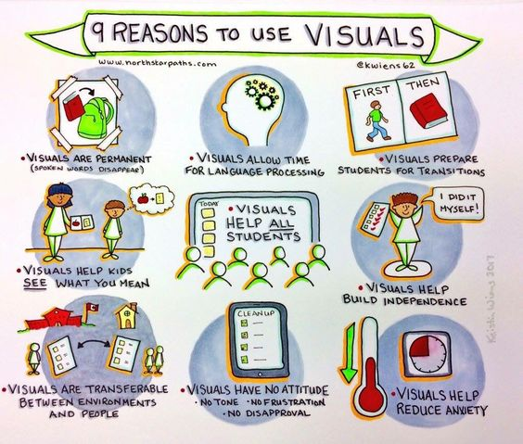

Slide 5
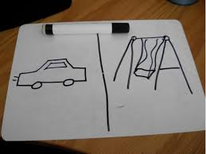
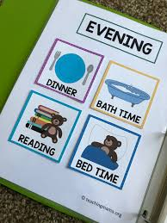
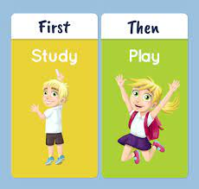
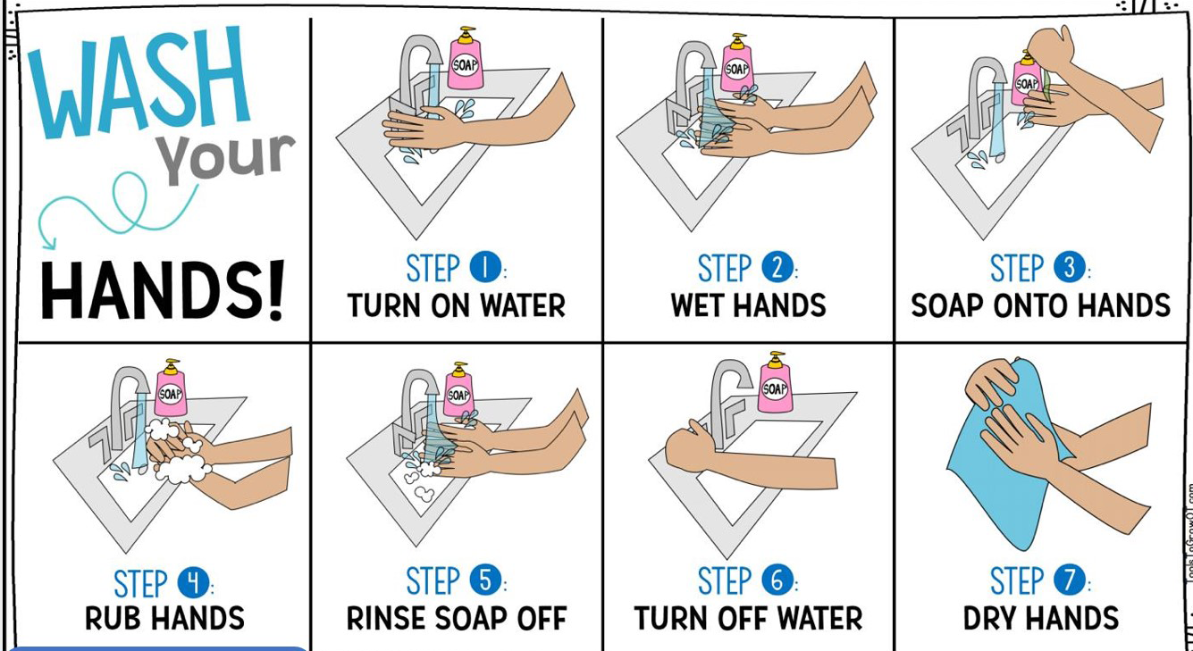
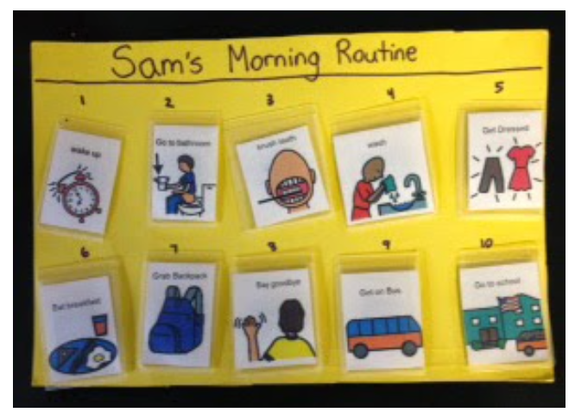
Idea’s of Visuals

Slide 6
Resources
Now and Next Board
First, Next and Then board
Editable visuals
Weekly schedule
“First I need to”
Daily schedule

Slide 7
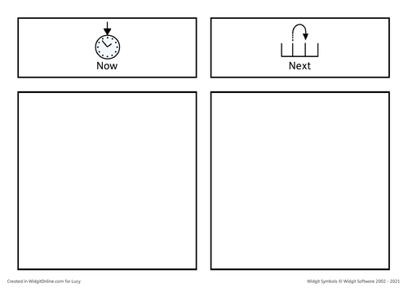

Slide 8
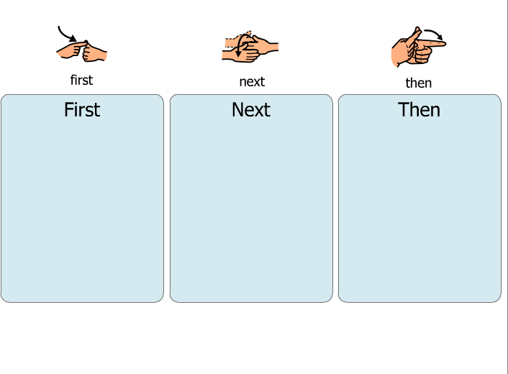

Slide 9
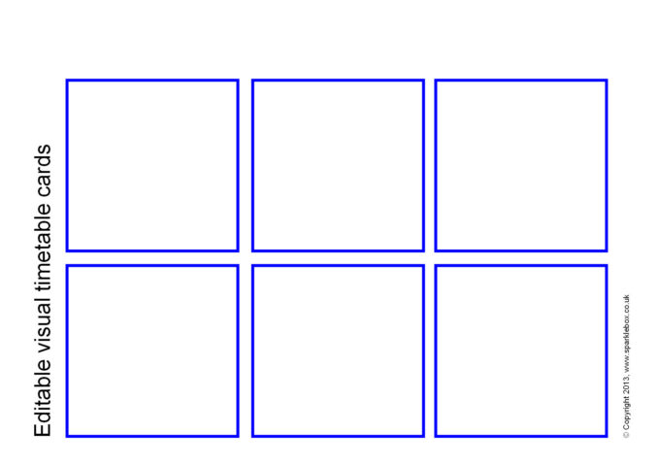

Slide 10
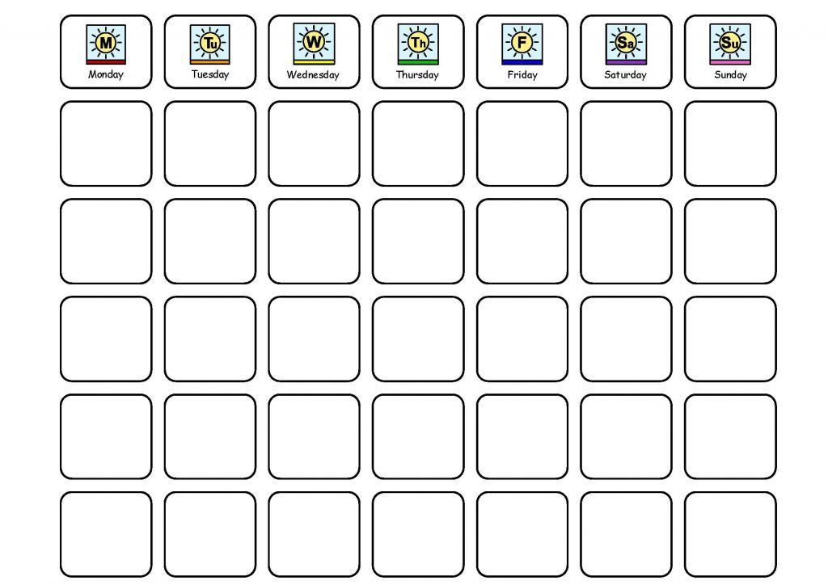

Slide 11
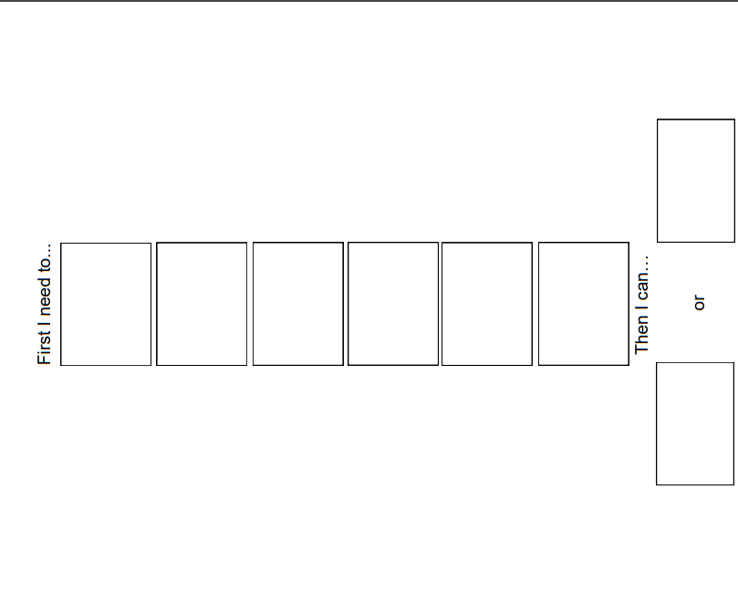

Slide 12


