Slide 1
BANYOLES, our town
By: Adam, Marc, Erik, Salva

Slide 2
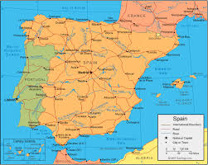
Banyoles is in Catalonia. Catalonia is in Spain and Spain is in Europe.
banyoles
Catalonia
Spain

Slide 3
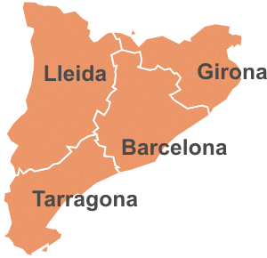
IN CATALONIA THERE ARE 4 PROVINCES: We live in the province of Girona.
We live here

Slide 4
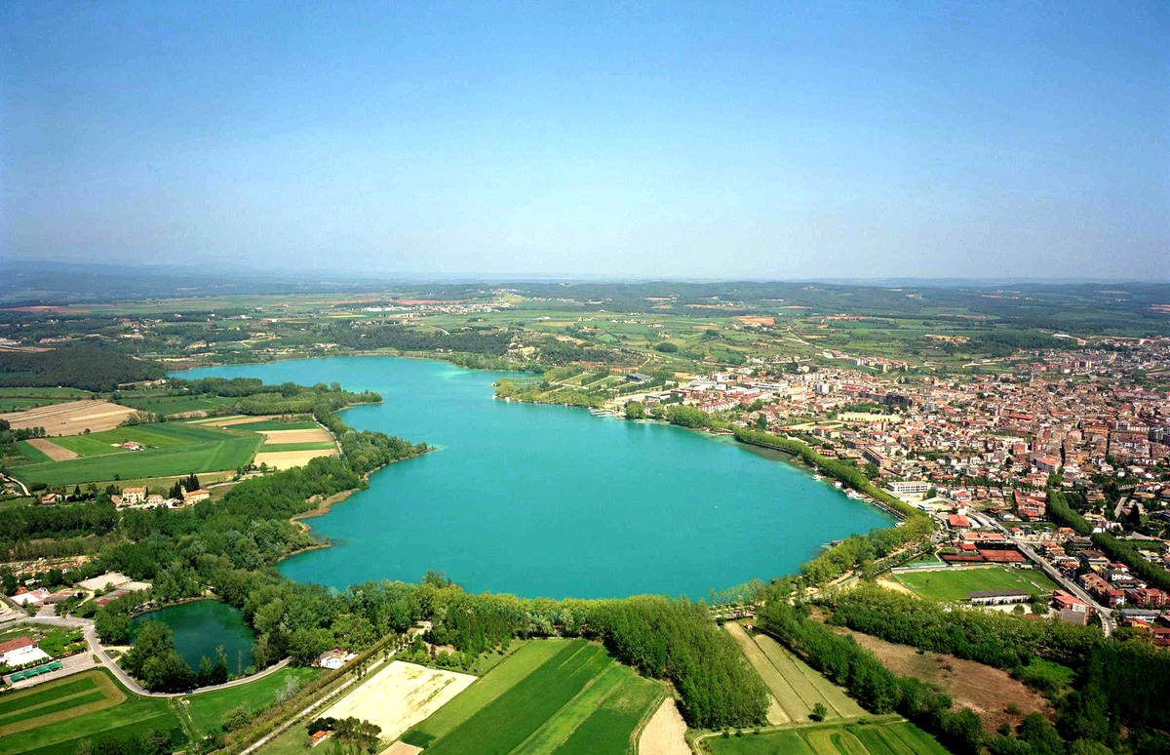
BANYOLES
Our city is Banyoles. In Banyoles there is an important lake. You can play a lot of sports there.

Slide 5
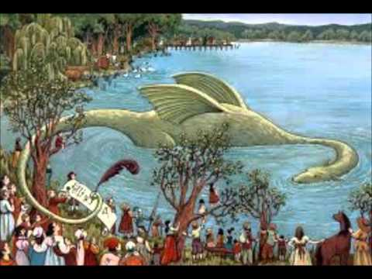
In Banyoles there is a legend about a dragon in the lake which ate people.

