Slide 1

We explore Banyoles
By Gustas-Edu-Neus-Núria
La Vila Baldiri Reixac 6th grade

Slide 2
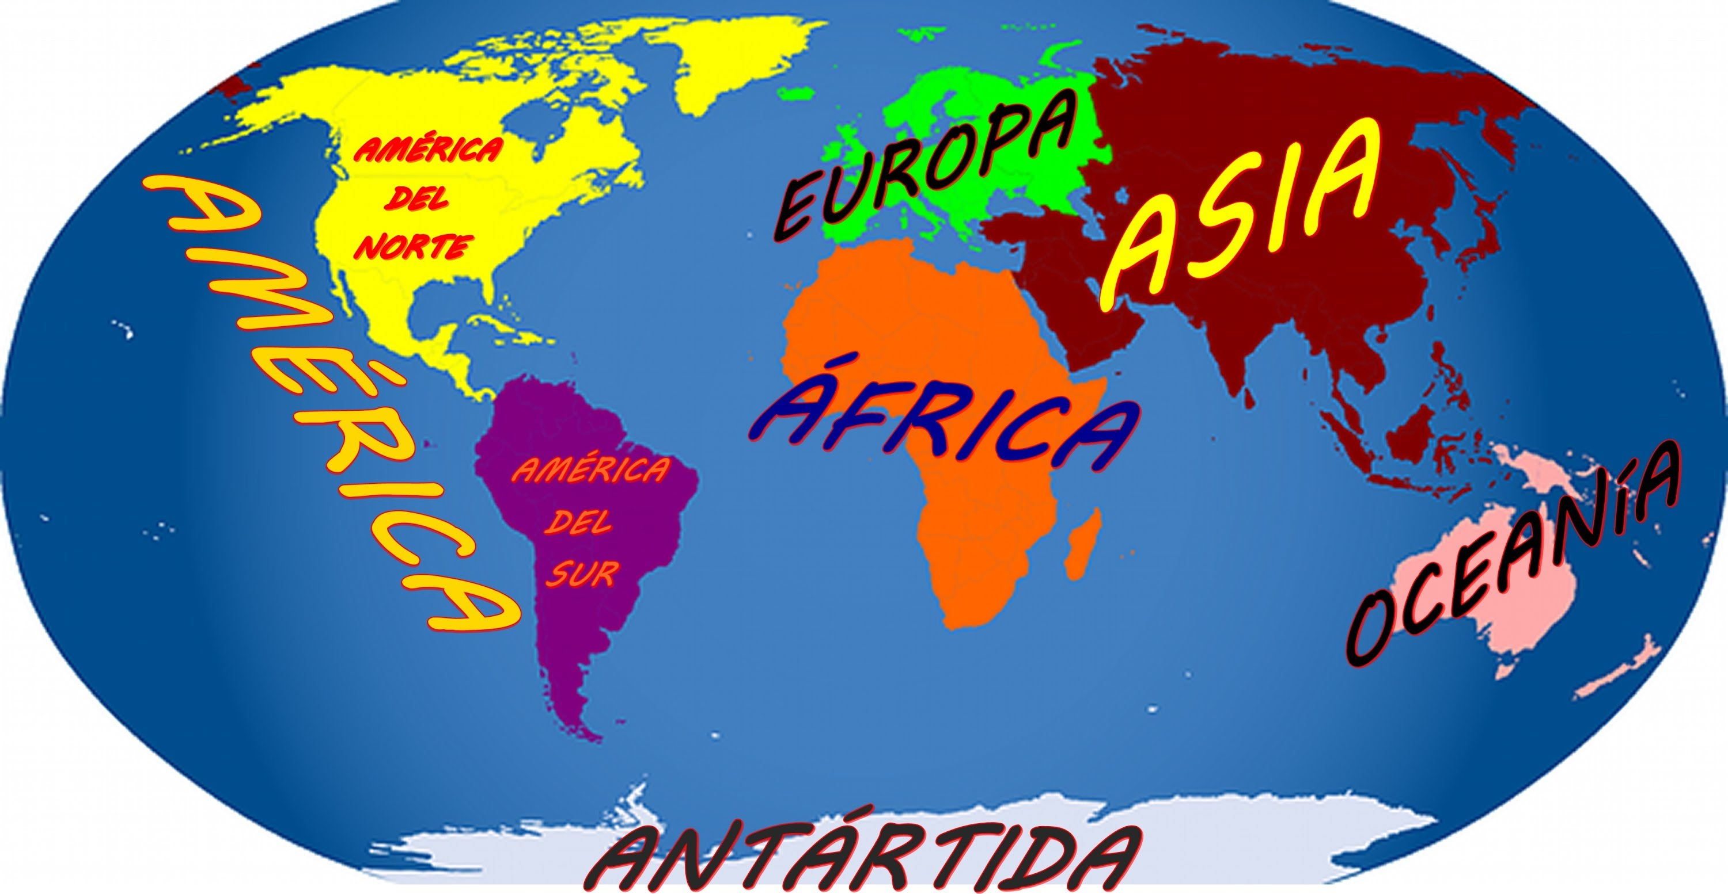
Banyoles is in Europe.
Europe is a continent.

Slide 3
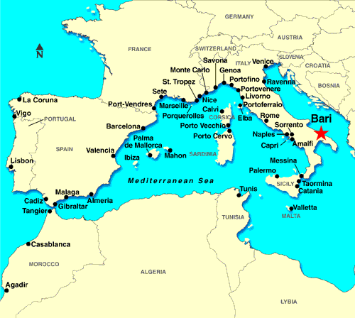
In Europe there is Spain
Spain is a country

Slide 4
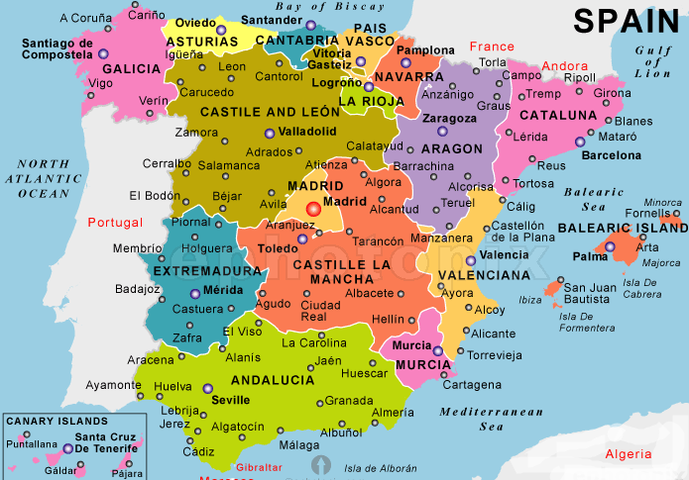
Catalonia is in Spain

Slide 5
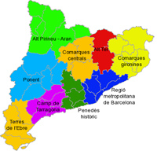
Girona is in Catalonia
Girona is a province

Slide 6
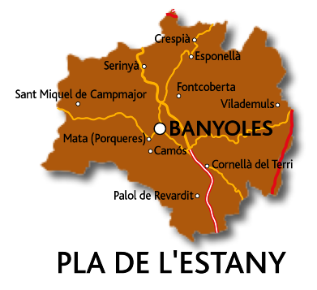
Banyoles is in the Pla de l’Estany.
Pla de l’Estany is a part of Girona

Slide 7
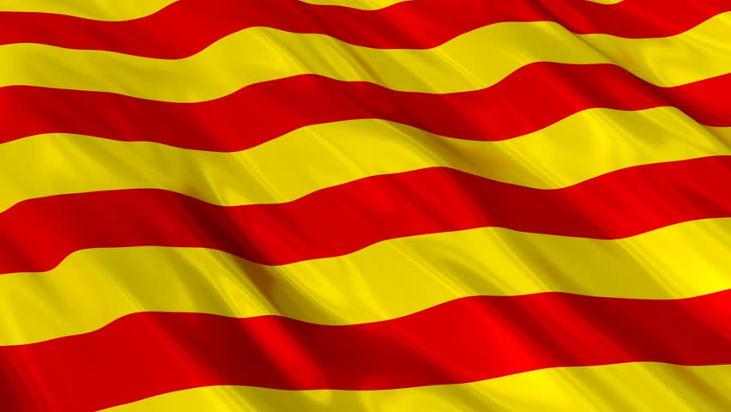
The Catalonia song is ‘’els Segadors’’ https://www.youtube.com/watch?v=Eyar4LaXg6w

Slide 8
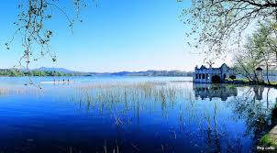
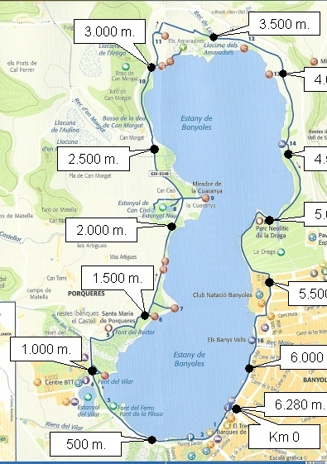
In Banyoles there is a lake.
It has an 8 shape.
Next to the lake there are “pesqueres”
(little houses).
This is “l’Estany de Banyoles”

Slide 9
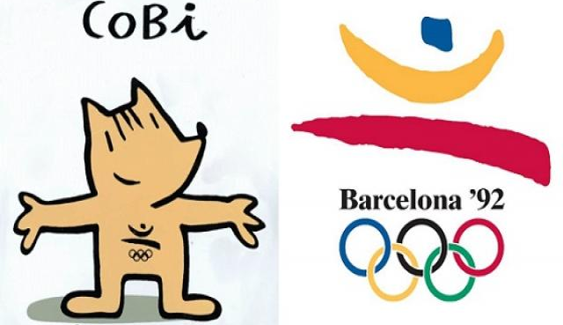
In Banyoles the Olympic players of the Olimpyc games of Barcelona 1992, came to Banyoles to row in the lake.

Slide 10

In Banyoles the most popular story is the monster of Banyoles

Slide 11
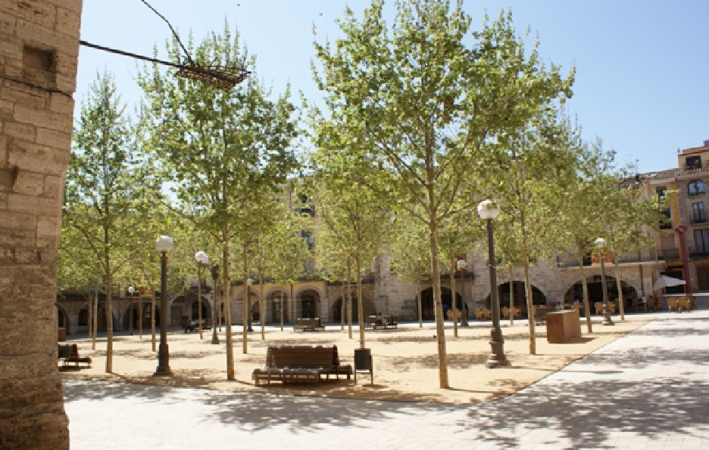
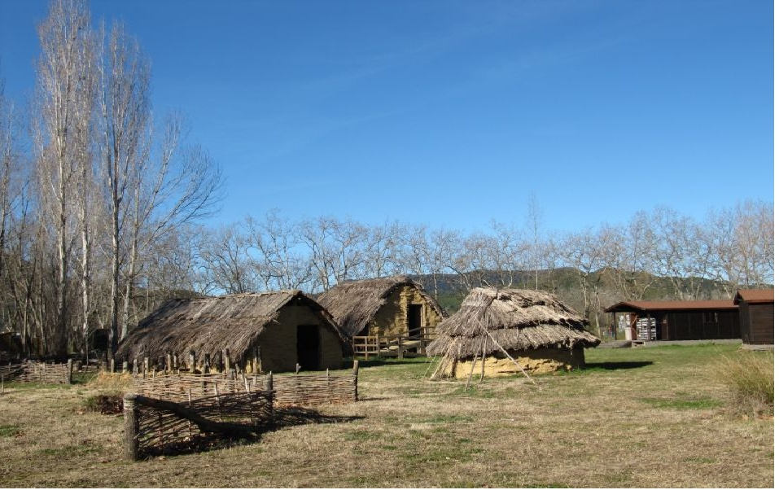
THE “PLAÇA MAJOR”
IS THE BIGGEST SQUARE IN BANYOLES.
THE PARK CALLED “LA DRAGA” IS NEAR THE LAKE AND THERE ARE PREHISTORIC HOUSES.

Slide 12
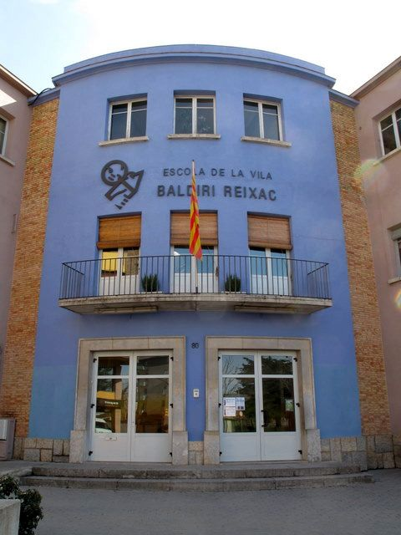
OUR SCHOOL
Our school’s name is
“La Vila Baldiri Reixac”.

Slide 13
In Catalonia the oficial languages are Catalan and Spanish.

Slide 14
VOCABULARY
Lake=Estany
Eight=Vuit
Hello/hi=Hola
Bye=Adéu
Thank you=Gràcies
Please=Siusplau
Reapers=Segadors
School=Escola
Village=Vila
Square=Plaça
Olympic games=Olimpíades

Slide 15
All the photos are from Google

