Slide 1
Strategies for Supporting Children’s Emotional Wellbeing
Mrs Reehal Learning Mentor, Mrs Chadwick SENDCO

Slide 2
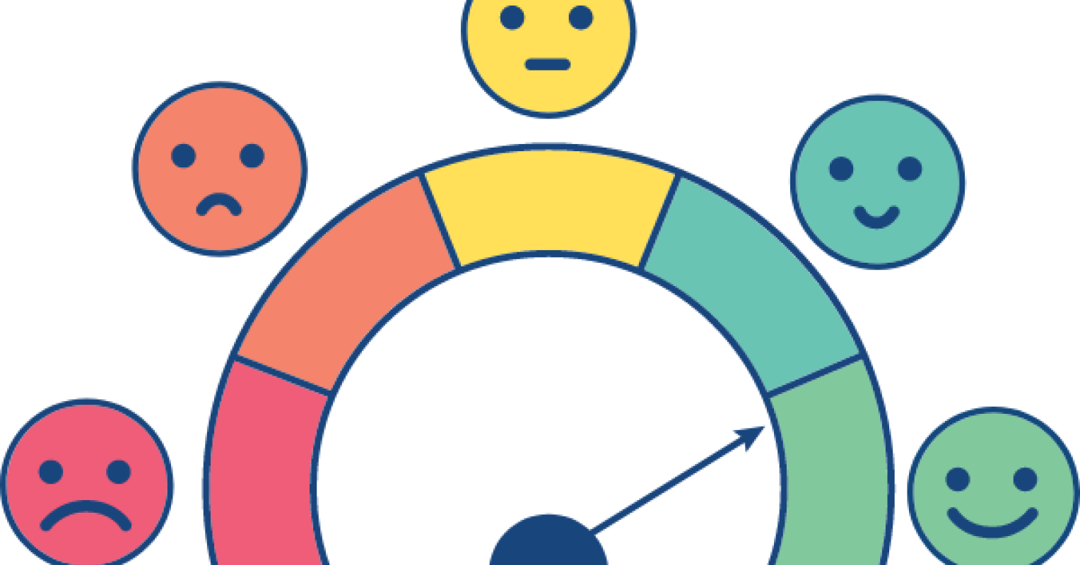
What is Emotional Wellbeing?
Emotional Wellbeing is about recognising, managing and expressing thoughts, feelings and behaviour. Recognising where and how feelings affect us in our bodies and minds. Stable wellbeing helps us cope with challenges, build resilience and maintain a positive sense of purpose.
Notes:
Visual reminder

Slide 3
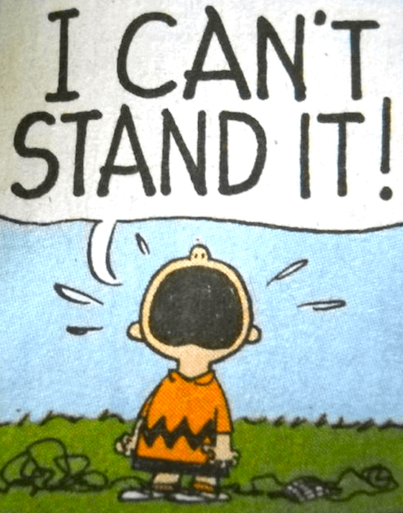
Uncomfortable Feelings
Uncomfortable feelings children experience include anxiety, stress, low mood, anger and low self-esteem/confidence. These feelings can affect children and be seen via changes in their behaviour e.g. withdrawn, changes in friendships and family relationships/dynamics, physical symptoms such as stomach pain and headaches, and can also affect sleep.

Slide 4
Strategies for Emotional Wellbeing can include:
Helping children to name and understand feelings. Activities: emotions/bear cards/feelings brainstorm/My Feelings/This is me.
All feelings are valid: “It’s OK to feel angry, but it’s not OK to hit” (separating the child as a person from their behaviour).
Exploring the root causes of feelings - is the anger masking other feelings such as anxiety, fear, hurt or embarrassment?

Slide 5
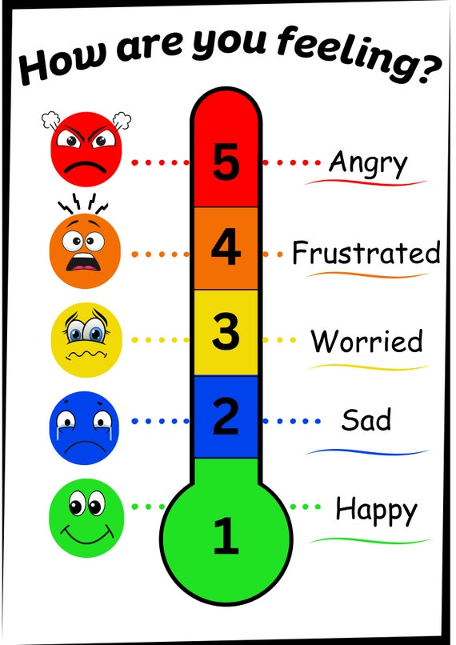
Strategies for Emotional Wellbeing can include:
Feelings Thermometer

Slide 6


Strategies for Emotional Wellbeing can include:
10-15 minutes of quality 1:1 time with your child. Use for talk time, playing games, arts &crafts, reading together.

Slide 7

Strategies for Emotional Wellbeing can include:
Open, honest age-appropriate conversations - you may not agree with what your child is saying, but it is key to communication and supporting wellbeing, that they feel they can talk to you, without interruption or judgement.
Active listening, using open-ended questions. Offer reassurance.
Communicating via talking, drawing and/or writing – not all children find it easy to communicate their feelings by talking.

Slide 8
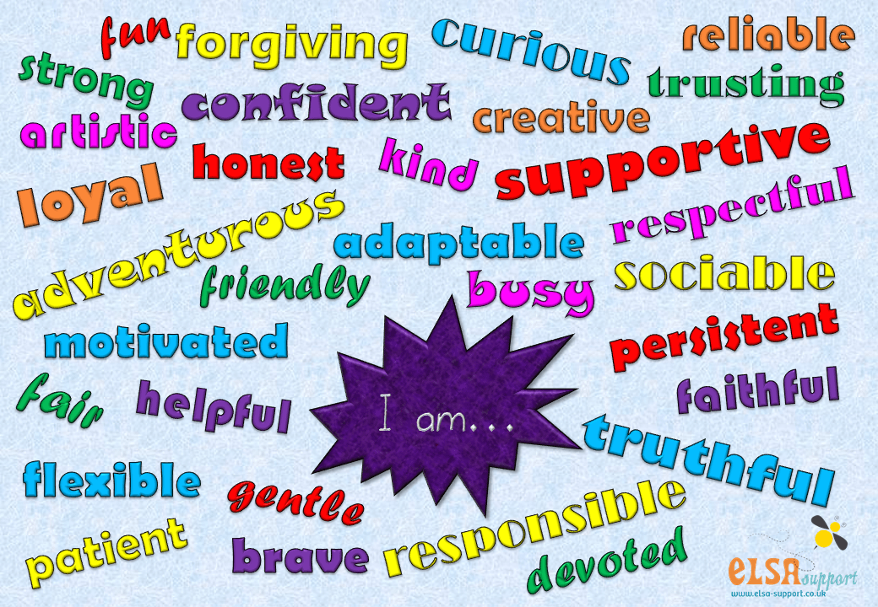
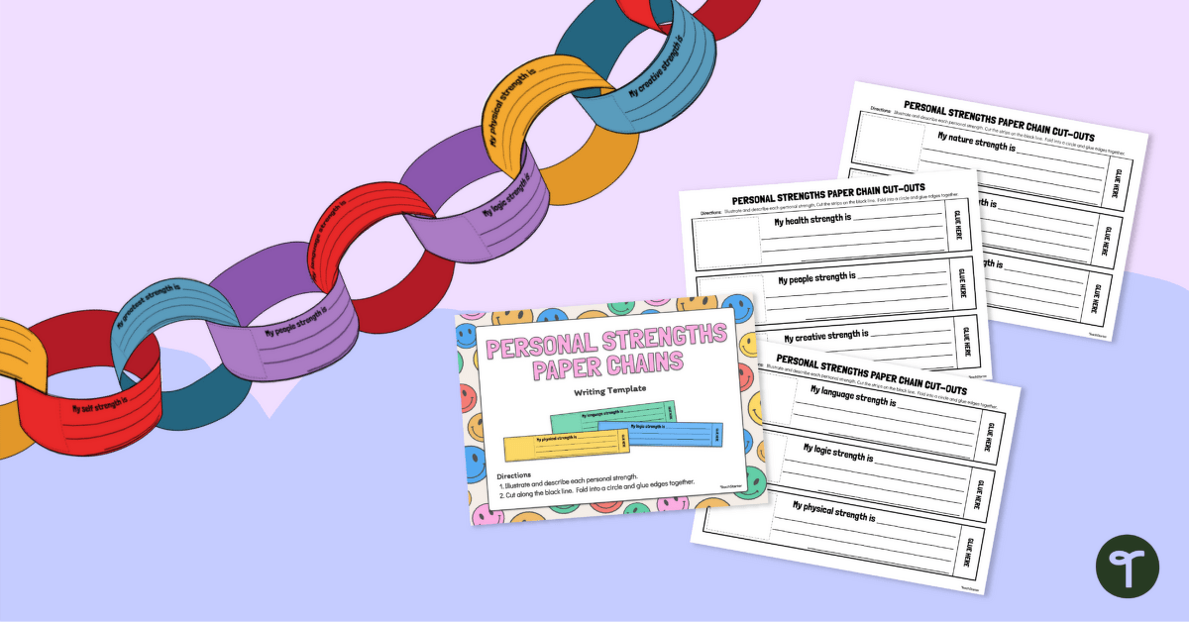
Strategies for Emotional Wellbeing can include:
Using role play, drama or stories, using the “third person” approach.
Strengths activity – builds self-esteem, confidence and resilience. Discuss and drip-feed strengths weekly.

Slide 9
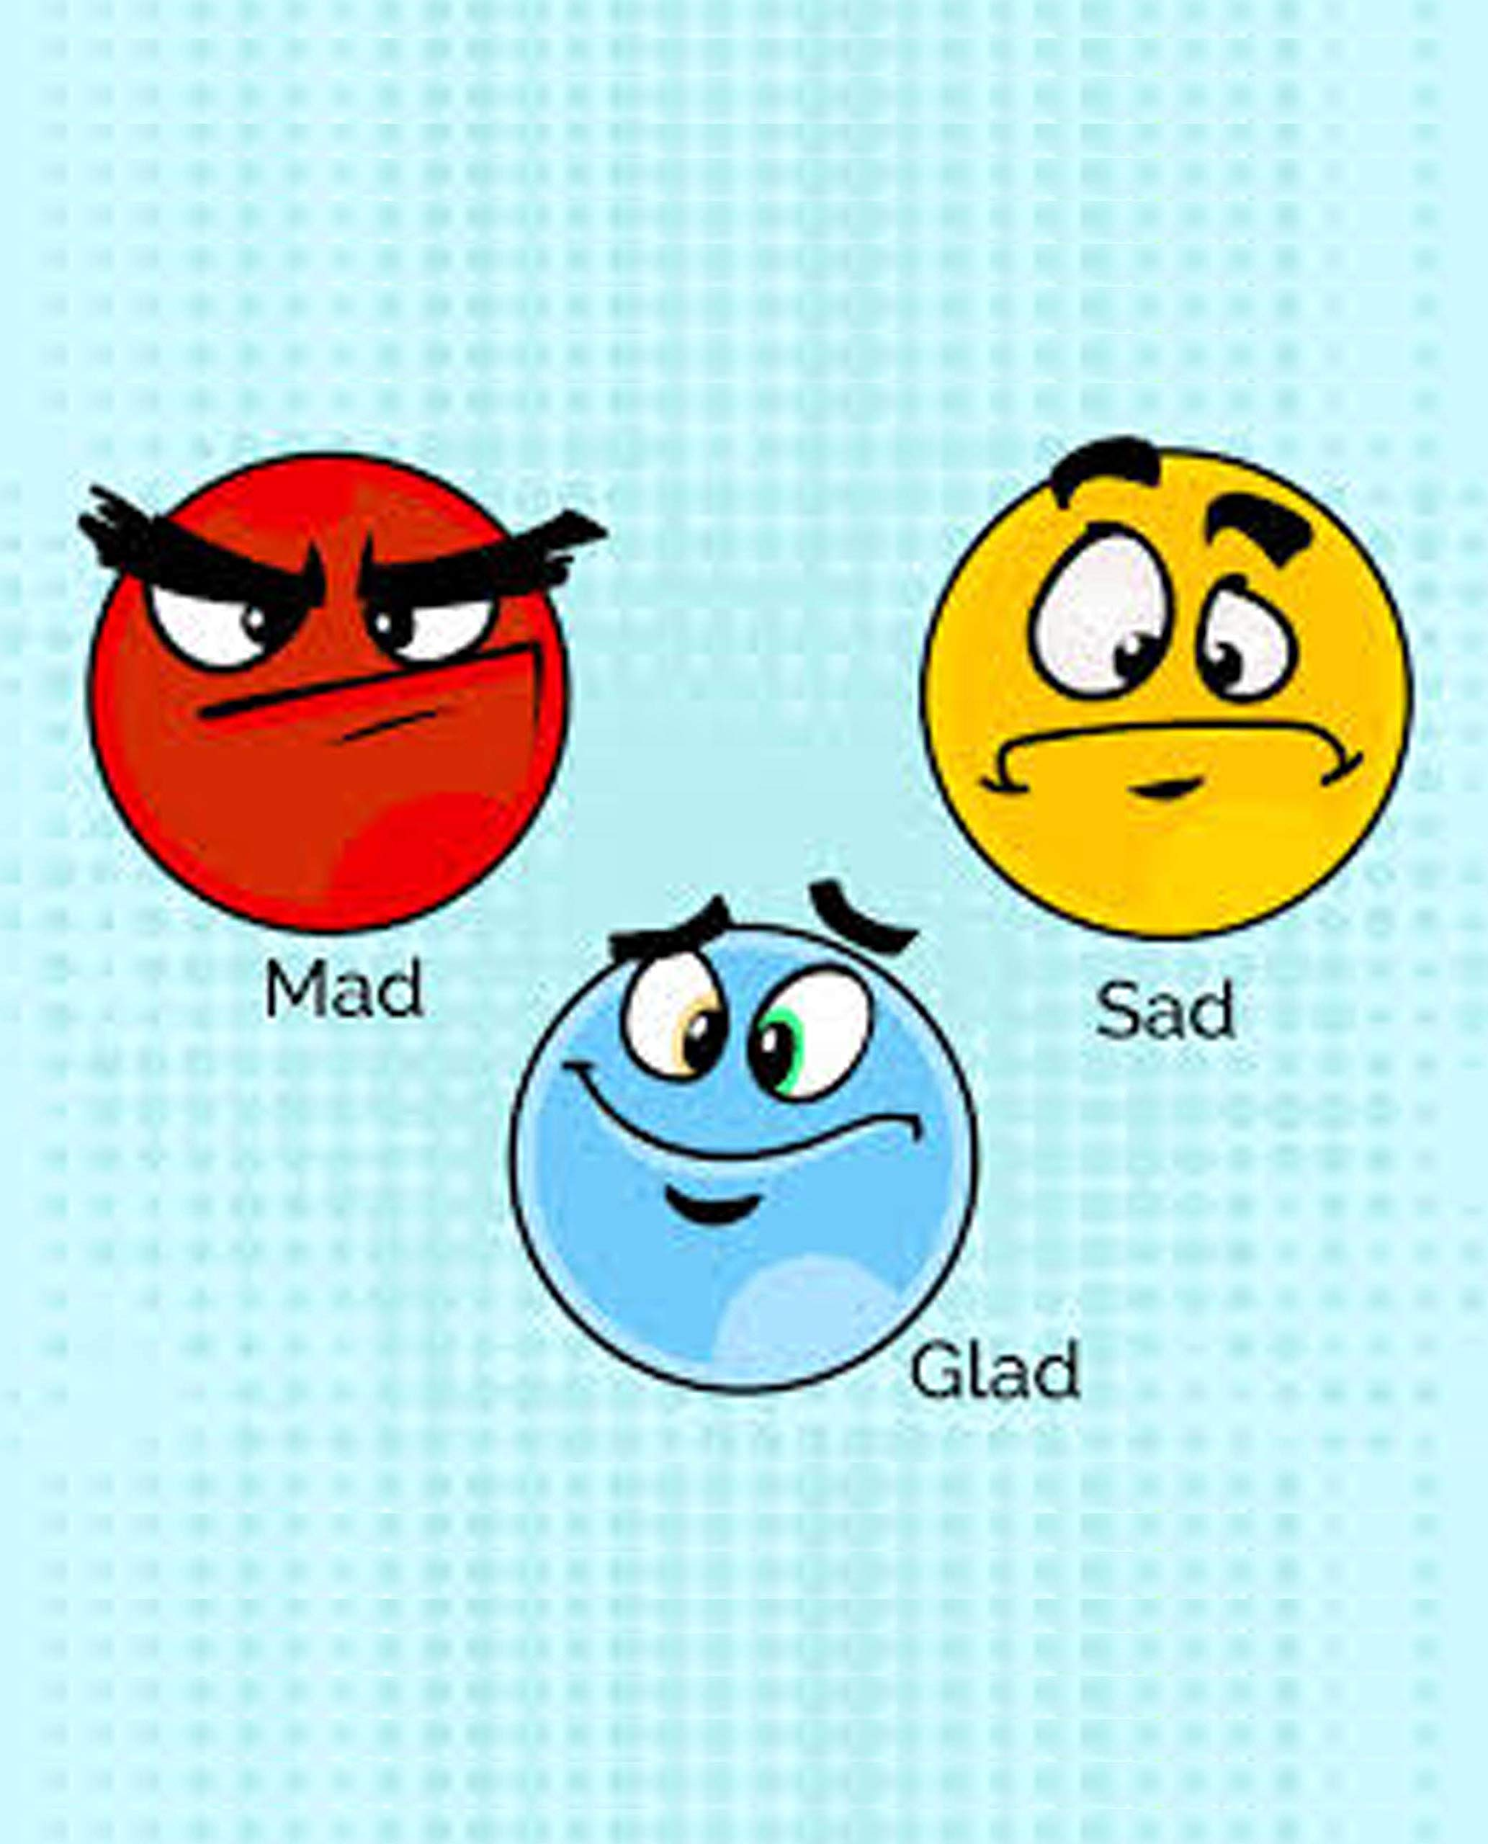
Strategies for Emotional Wellbeing can include:
Reflecting at the end of the day – What made you feel mad, sad or glad?

Slide 10
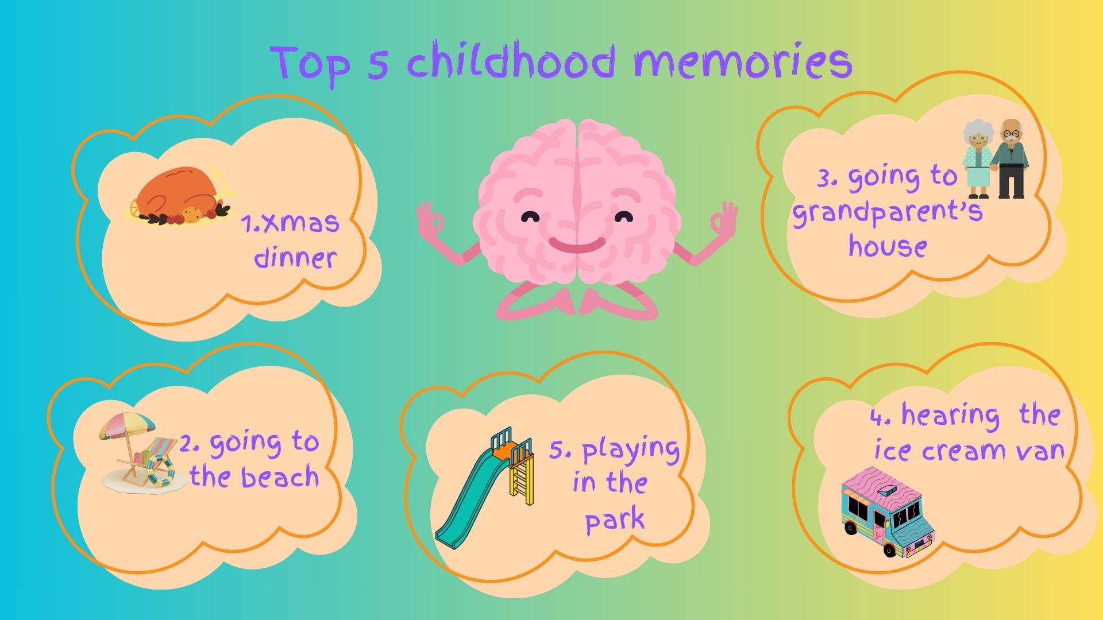
Strategies for Emotional Wellbeing can include:
Good Things List.

Slide 11
Strategies for Emotional Wellbeing can include:
“Something to look forward to”, using countdown mode and visualisation to maintain a positive mindset and outlook.
What if “……………….” Happens? Challenge Mindset > “But what if it doesn’t?”
Visualisations – red balloon/cloud floating away with your worries; picturing your family, pet etc.

Slide 12

Strategies for Emotional Wellbeing can include:
Scrunching up your feelings, aiming for the bin.
Distraction (talk of their interests and hobbies). Use of humour.
Diaries and scrapbooks. Use of emojis to track mood. Tracking triggers.

Slide 13
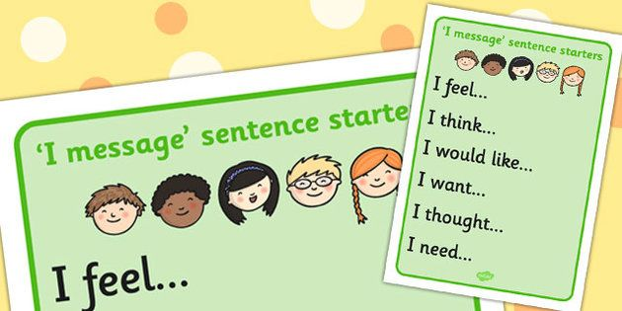
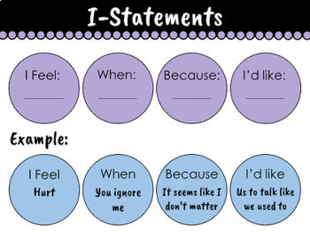
Strategies for Emotional Wellbeing can include:
Sentence starters, including I statements, to help enable expression of feelings and initiate conversations.
Talking to five key adults.

Slide 14
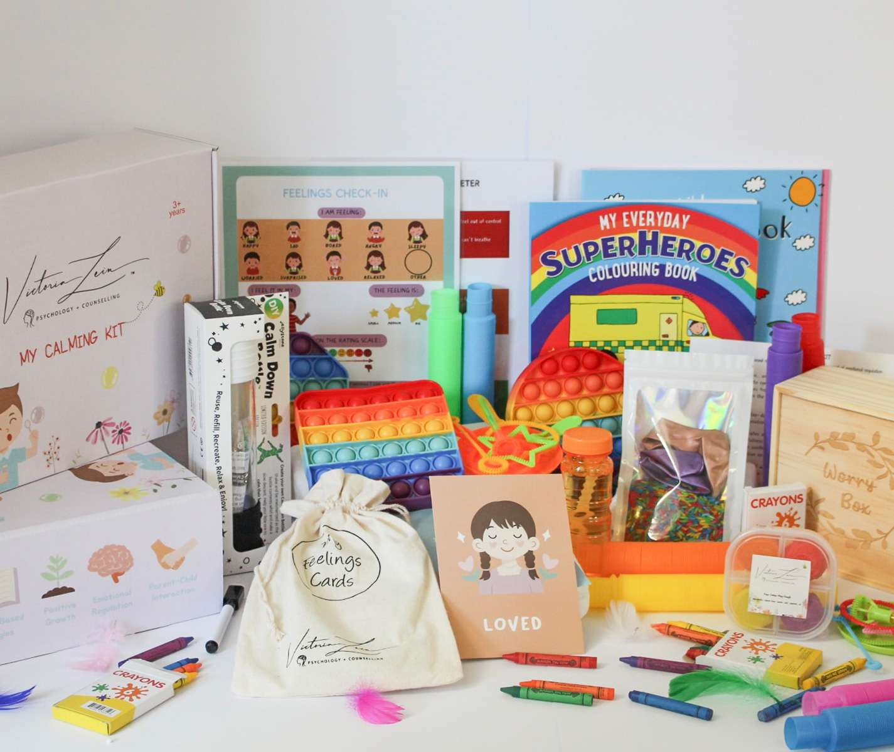
Strategies for Emotional Wellbeing can include:
Having a calm box

Slide 15
Strategies for Emotional Wellbeing can include:
Grounding techniques
Breathing exercises
Positive Affirmations – “I can do this!”

Slide 16
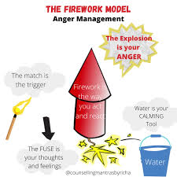
Strategies for Emotional Wellbeing can include:
Anger management techniques – Anger Dance, The Brick Wall, The Firework Analogy.
Taking time to relax, play, and enjoy activities, eating healthy foods, getting exercise and getting plenty of sleep (8-12 hours for children) are all key to good mental and emotional wellbeing.

Slide 17
Key Messages:
Football discipline analogy/Gaming analogy.
*No quick fix or miracle cures!
Things can change.

Slide 18
Parent Discussion:
*What Strategies have you used/do you use with your children to help with their emotional wellbeing? Are the strategies effective?
FL Feelings Cards – what are the children feeling?

Slide 19
Resources – some examples
Emotions figures, Bear cards, Questions games
Movies such as Inside Out, encouraging talk about feelings and emotions.
Books:
“Helping your child with fears and worries” by Cathy Creswell
“What to do when you worry too much” by Dawn Huebner
“Bottled” by Tom & Joe Brassington
Ruby’s Worry: A Big Bright Feelings Book by Tom Percival
Muddles, Puddles and Sunshine – activity book to help when someone has died by Winston’s Wish

Slide 20
Useful websites and Organisations:
Action for Children Parent Talk – offers help with parenting questions. Find answers in their advice articles or speak to a parenting coach on their webchat and WhatsApp service:
https://parents.actionforchildren.org.uk/how-we-can-help/
Childline’s Calm Zone page – breathing exercises, activities, games and videos to help children let go of stress and anxiety:
https://www.childline.org.uk/toolbox/calm-zone/

Slide 21
Useful websites and Organisations:
Home Start Ealing – provide emotional and practical help to families with one or more children under the age of 5; offer home visiting support and family group support:
https://homestartealing.org/getting-support/
SAFE – offering early help to families:
https://www.ealing.gov.uk/info/201023/children_and_families_social_care/1187/safe_-_supportive_action_for_families_in_ealing

Slide 22
Useful websites and Organisations:
Family Lives: Offering comprehensive parent and family resources, including a parent helpline, online chat, advice articles and online parenting courses:
https://www.coramfamilylives.org.uk/
Youngminds: information and advice for your child’s mental health:
https://www.youngminds.org.uk/

Slide 23
Useful websites and Organisations:
Family Links: Ten-week parenting course, run at Fielding Primary:
https://www.centreforemotionalhealth.org.uk/emotional-health/the-nurturing-programme/
The Circle Café: A safe space for children to talk about mental health:
https://www.wlmind.org.uk/get-support/service-for-schools/support-for-children-young-people/circle-cafe-childrens-hub/

Slide 24
Thank you for joining us today – we hope you have found the drop-in session useful.
We would really sppreciate it if you could take a minute or two to complete an evaluation form and tell us your thoughts!

