Slide 1
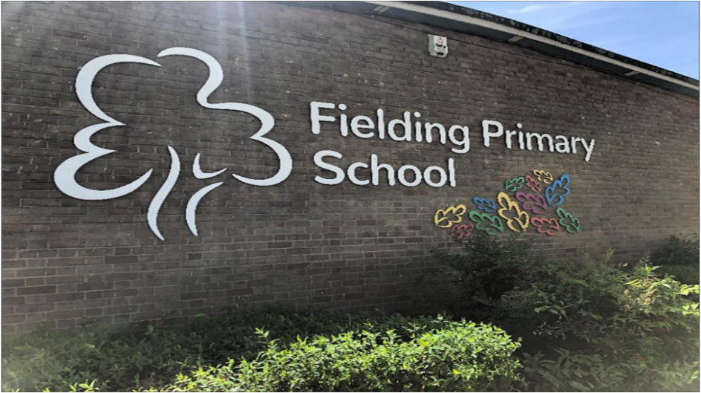

Starting School
2026 - 2027

Slide 2
Meet the Reception Team
Teachers:
RH – Mrs Robinson
RF – Mrs Watts
RP – Miss Karim
RS – Mrs Strickland
Support Staff:
EYP – Mrs Mirbaz
EYP – Mrs Hiba
TA – Mrs Bonnet
TA – Mrs Emilija

Slide 3
Welcome to RS
Mrs Strickland | Class teacher
30
children
Henry Fielding Primary School
RS | 1S | 2S | 3S | 4S | 5S | 6S

Slide 4

Our aims for your child
By the end of the Reception year, we want your child to be happy, confident and resilient. We want them to be inquisitive, take risks, run, jump and explore their surroundings; to be able to read, write, count and to be ready to continue their learning in Year 1.

Slide 5
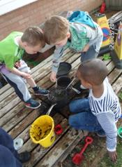
Our First Half Term in School
Settling in, focus on developing relationships, children being happy
No staggered start to support transition
Parent Consultation Meetings – 21st & 28th September
Outside sessions – children feel safe, own play area
Mealtimes – class adults stay with children to support
Values-based ethos, Focus on Self-Regulation;
‘Stay and Play’ sessions for parents

Slide 6
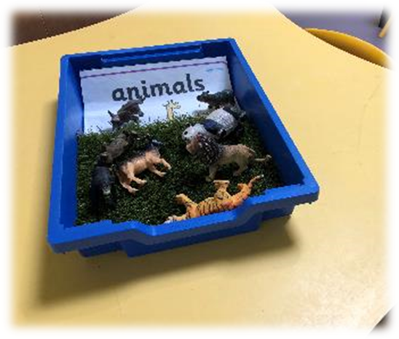
A typical week for your child
Daily carpet sessions in mathematics and literacy, wider curriculum subjects – Fielding Challenge Curriculum, RHSE, RE, No Outsiders, Values and Mind Up
‘Play’ – learning through play in our inside and outside learning spaces. More formal learning in Year 1+
Small group learning sessions (move children on from starting points)
Daily phonics, story time, singing and poetry
Additional support and interventions for children with additional needs or learning English for the first time.

Slide 7
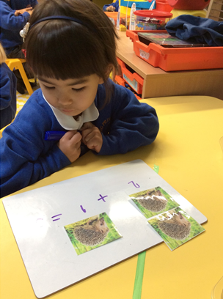
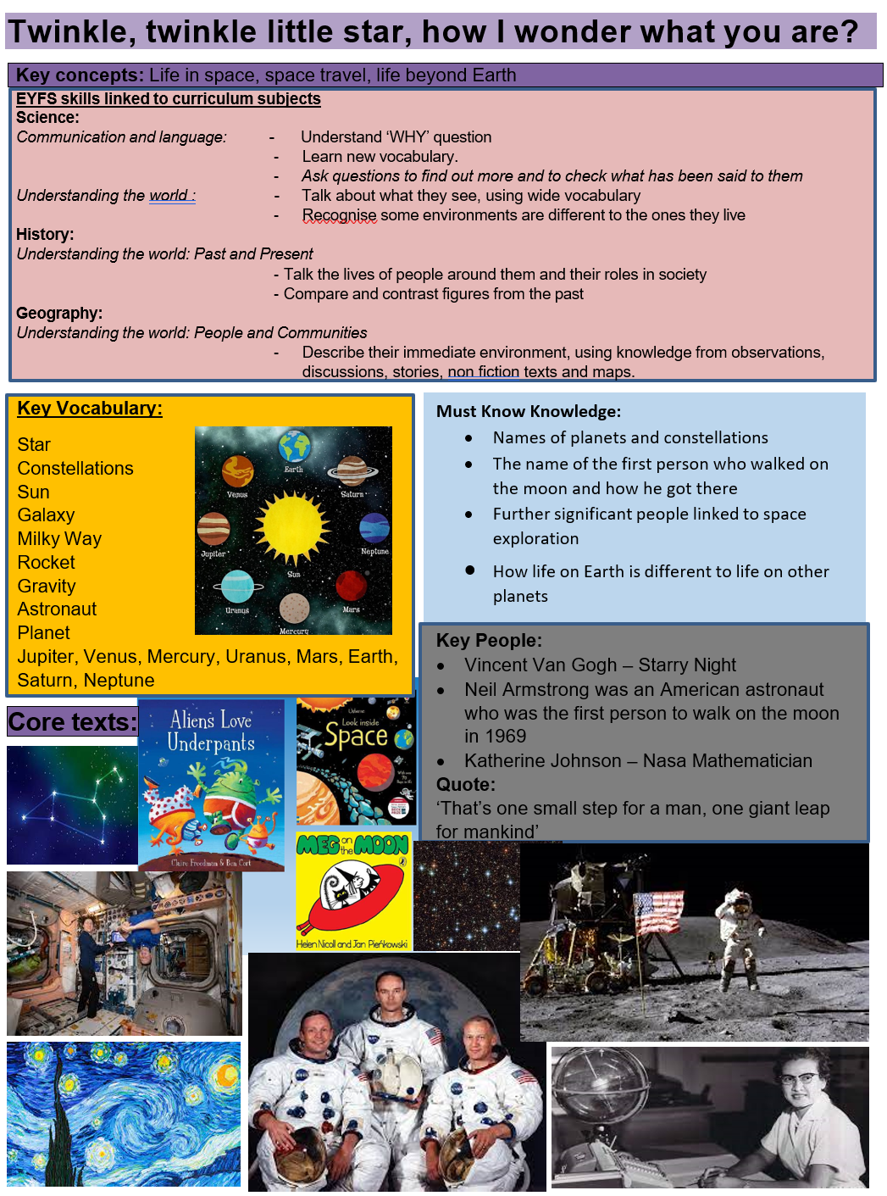
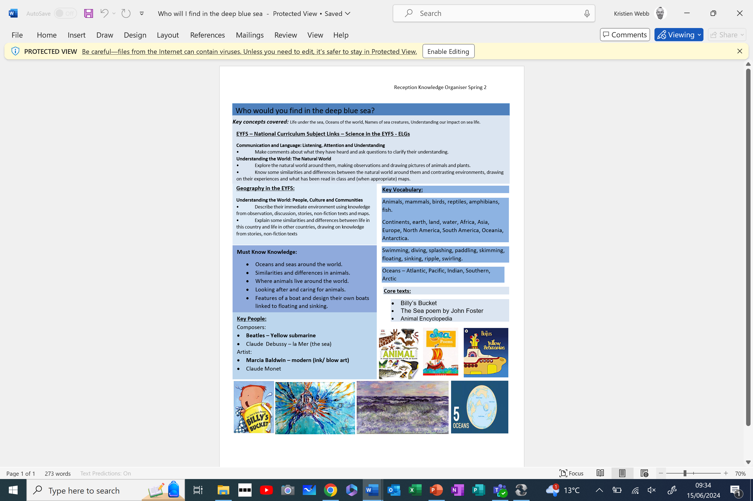


Our Curriculum

Slide 8

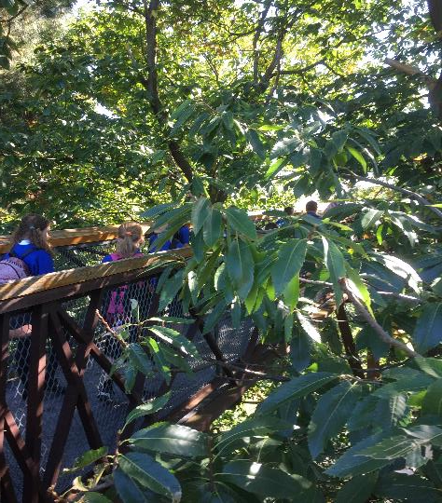
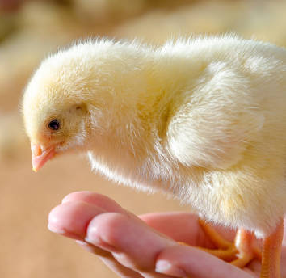
Unique to Fielding
Fielding Forest school
Specialist Music, French and PE lessons
Specialist Clubs
Golden moments:
Zoo Visit, Chicks
Trips linked to our learning challenges

Slide 9
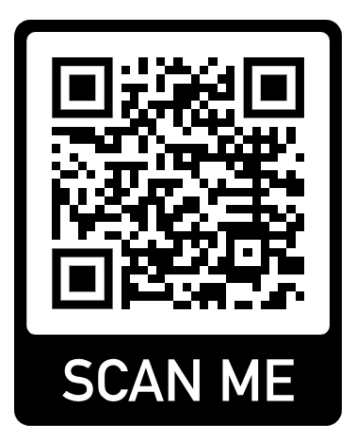
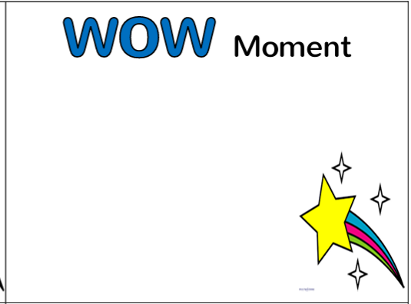
Parent Involvement
Stay and Play sessions
Trips – Parent Volunteers Needed
Parent Readers
PTFA - https://www.fieldingprimary.com/ptfa/
Reading with your child – recording in reading record daily
Home Learning – Phonics and key words (individual activities if needed)
Reception Notice board (updated every Friday)
Termly Parent Consultation Meetings
Wow Moments

Slide 10
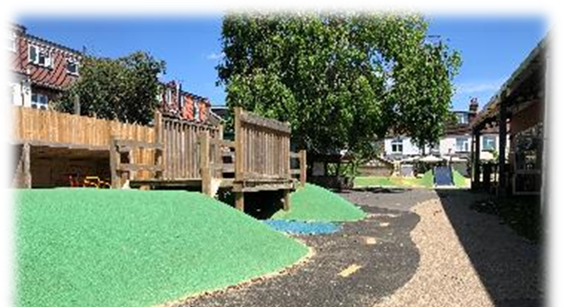
Our Routines
Morning drop off – 8.45am to 9.00am
Afternoon pick up – 3.30pm (child go to ASC after 3.45pm)
Soft Start – 8.45am – 9.00am. Classroom doors close at 9am – if door is closed, please take child to the office.
Breakfast/After School and Specialist Clubs collect from classroom

Slide 11

After school Clubs/Specialist Clubs
Friday 3rd July – programme of specialist clubs on website
Specialist clubs go ‘live’ for Reception – 7th July at 8pm
Check your login details work so you are able to book
Small healthy snack needed
https://www.fieldingprimary.com/specialist-clubs/

Slide 12
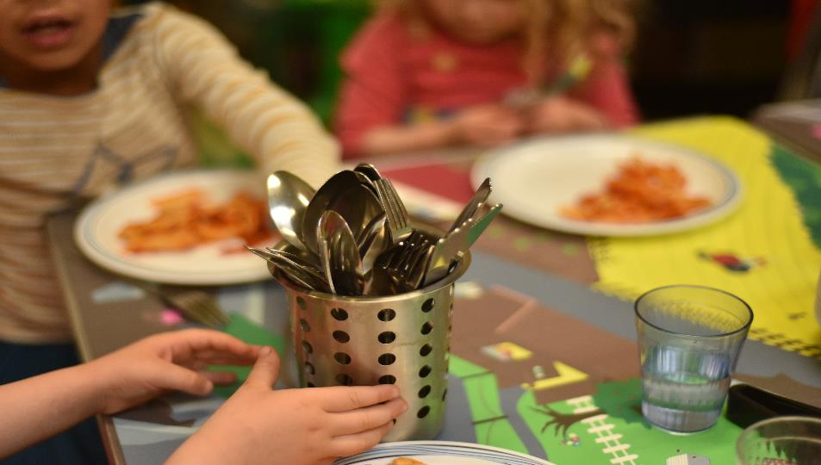

Eating together ‘Family style dining’
Learning to use a knife and fork (fine motor)
Social communication
Hesitant eaters (sharing new tastes)
ISS Catering Company prepare freshly cooked food on the premises;
Can meet all dietary needs (inform class teacher)
Options each day, including vegetarian, Halal options;
Menu online to check
Speak to Marsha around any children who need special meal due to allergy.
Packed Lunch option

Slide 13
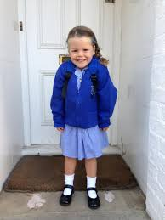
Getting ready for the first day
uniform – all items to be labelled and easy fastening (Velcro shoes)
wear PE kit to school on Thursday
Reading folder (gift in Autumn if new to Fielding)
labelled water bottle and fruit container
spare set of clothes
wellington boots for Fielding Forest sessions
PE bag on club days (example-ballet)

Slide 14

Preparing your child over the summer
Talk about routines
Toilet training if needed (essential)
If your child is anxious (walk past school regularly, practise your walk to school)
Talk with positivity about school
Read the Colour Monster – talk about feelings

Slide 15





Rest of the Evening
5.30pm-6.00pm Time to connect
Second hand uniform shop open
Check your child’s dietary/medical needs
Meet ISS (RS classroom)
6.00pm – 6.15pm Meet the Mr Dunmall & Mrs Haines (sports hall)
if new to Fielding
PTFA Reps - Sign up to your class WhatsApp group
Contact and follow us:
020 8567 9524
admin@fielding.ealing.sch.uk
https://www.facebook.com/fielding.primary/
@fieldingprimary

