Slide 1


Recognising Child Anxiety and Behavioural Difficulties
Louise and Cherelle
Ealing Mental Health Support Team

Slide 2
About our service
Ealing Mental Health Support Team is a new service designed to support the wellbeing of children and young people in education settings at the first signs of difficulty. MHST is made up of Wellbeing Practitioners.
We aim to help children in primary school who are having difficulties with
Anxiety – feeling worried, separation anxiety, phobias
Behavioural difficulties - refusing to follow instructions, sibling arguments
We can offer up to eight 1:1 sessions of CBT based guided self-help to parents, equipping them with a toolbox of coping strategies.
Please speak to your child’s class teacher if you would like to find out more about our service or think you would benefit from support.
Notes:
I’m the allocated practitioner support Downe Manor – working with families since last year

Slide 3
Plan
Anxiety
What is anxiety?
What does anxiety look like?
How can I help my child manage their anxiety?
Behavioural difficulties
What is difficult behaviour?
What does difficult behaviour look like?
How can I manage my child’s behaviour?
Questions

Slide 4
Child Anxiety

Slide 5

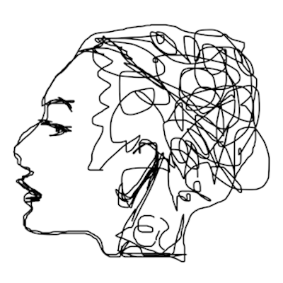


What is anxiety?
Anxiety is a normal emotion and everyone experiences it particularly in response to big changes (e.g. new school/class) or stressful life events (e.g. tests)
Anxiety is our natural alarm system, known as the ‘fight or flight response’ which goes off when we perceive that we are under threat or in danger. In normal amounts, it can be useful and helpful.
Sometimes the alarm system is faulty. It goes off when it shouldn’t – when there is no danger. This can cause anxious thoughts, feelings, physical sensations and behaviours.
Notes:
Natural alarm system - It kickstarts our ‘fight or flight’ response, which prepares us to fight or run away from danger.
COVID-19 has had a huge impact on young people’s lives, and so it is very likely that a lot of people will experience anxiety as a result.

Slide 6

What impacts anxiety?
Parental mental health
Personality/temperament
Genetics
Not going to school
Not seeing friends
Loneliness
Staying indoors
Fears/phobias
Issues with money
Learning from people around us
Stressful life events
Responses to worries
Family tensions
Avoidance
Issues at school/work
reassurance
Missing out on things
Lack of routine
Health worries
Loss or bereavement
Notes:
Anxiety is influenced by 3 things – never just one thing to cause it

Slide 7
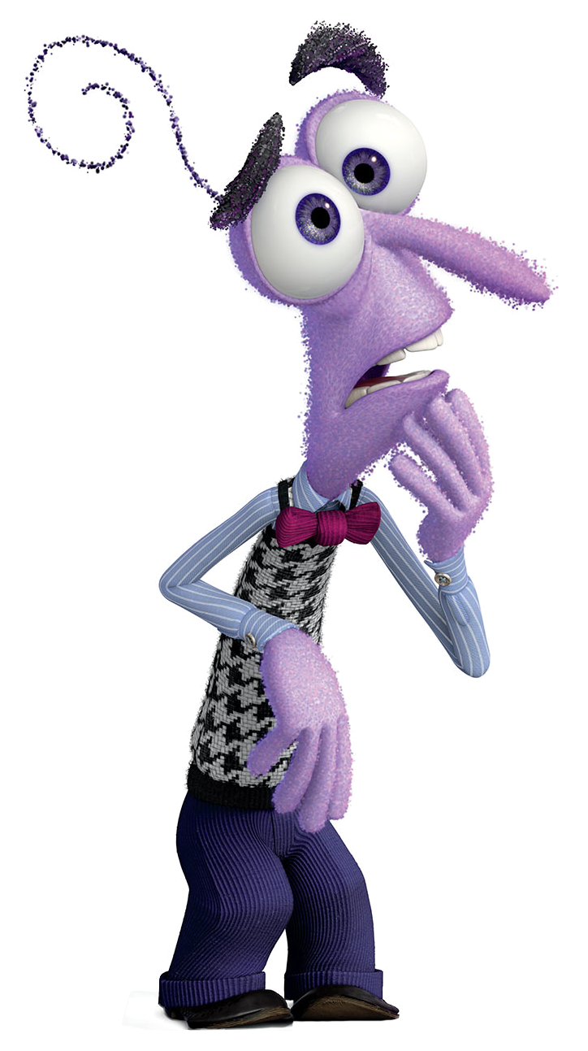
How do you know when a child is anxious?
Notes:
ASK PARENTS IN CHAT

Slide 8

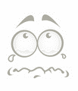
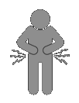

Signs and symptoms of anxiety
Thoughts: “I’m not safe”, “people will judge me”, “what if…?”
Feelings: scared, anxious, terrified, worried, stressed
Physical sensations: stomach aches/butterflies, feeling unwell, headaches, heart racing, breathing fast, wide eyes, shaking, sweating, going red
Behaviours: avoiding certain places or situations, avoiding eye contact, seeking reassurance, difficulty sleeping, not eating properly, being clingy, always worrying, crying a lot, getting angry or irritated more often
Notes:
Anxiety isn’t just an unpleasant emotion, it affects what we feel in our bodies, what we think and how we behave.
These are some common signs to look out for that might indicate that someone is struggling with anxiety
Thoughts
We obviously cannot know what other people are thinking, so we have to pay attention to what people say.
E.g. “what if” statements – “what if my mum gets sick?”, “what if everyone laughs at me”, “what if I have a panic attack and I stop breathing?”
Body sensations
Frequent complaints about feeling unwell (e.g. stomach aches, headaches)
Behaviour
Seeking reassurance e.g. ”will everything be okay?” “will you be there to help me?” “are we still friends?” repeatedly asking teacher to check work for mistakes, calling parents from school to check they are okay
Constantly tired
Missing school, skipping certain lessons, skipping tests

Slide 9
Types of anxiety
There are different types of anxiety, these are the most common in children:
Generalised anxiety – “a bit of a worrier”
Anxiety in social situations (meeting new people, school performance)
Anxiety about being apart from parents/carers (separation)
Phobias (e.g. spiders, dogs, heights, the dark)
Panic attacks (overwhelming physical symptoms)
Obsessive thoughts and behaviours (repetition, ‘needing’ things a certain way/in a certain order)
Notes:
Different worries at different ages e.g. separation anxiety normal in babies (cry when not with mother)
COVID-19 has had a huge impact on young people’s lives, and so it is very likely that a lot of people will experience anxiety as a result.

Slide 10

Why do we get these feelings in our body?
THOUGHTS RACING:
Alertness increases for quick decision making.
DRY MOUTH: There is decreased flow of saliva as energy is diverted toward the muscles.
FAST/SHALLOW BREATHING: Your breathing rate increases to increase oxygen in your blood. This can sometimes make us light-headed.
SWEATING: Sweating increases to cool us down in preparation for ‘fighting’ or ‘running’.
HEART: Your heart begins to beat faster and harder to pump blood to your major muscles to use for energy.
TENSE MUSCLES: Increased blood and energy flow to your major muscles to help you to fight or run away.
NAUSEA/‘BUTTERFLIES’ IN STOMACH: Digestion slows down as blood supply is diverted elsewhere.

Slide 11

Draw a body map and talk with your child about what funny or uncomfortable feelings they get in their body when they feel worried/anxious and why they get these feelings.
This will help them understand that these feelings are:
Related to their worries/fears
Normal
Not dangerous
TOP TIP: Tell them what how your body feels when you are worried and ask if they feel that too.

Slide 12
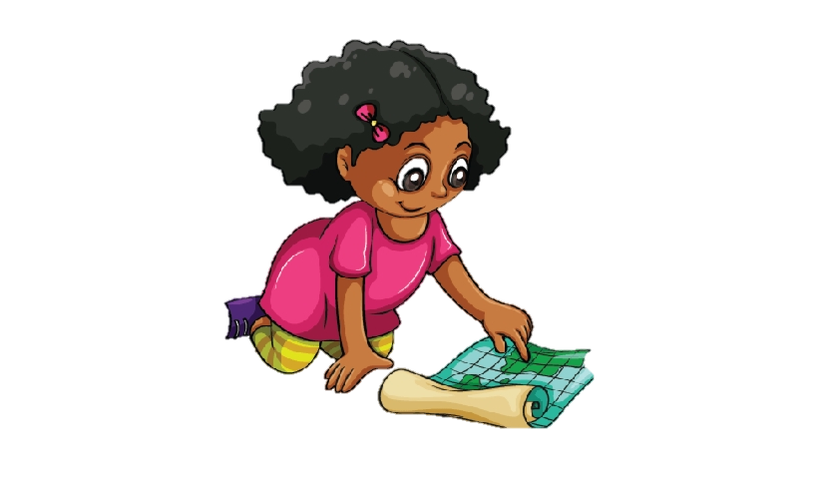
Anxiety example
Temi is in Year 3. She used to really enjoy going to school.
Mum has noticed that when she drops Temi off at school, Temi is finding it harder to let go of her mum in the mornings. Sometimes she even cries at the school gate.
Temi often complains of headaches and a tummy ache in the mornings before she would get ready to go to school. Sometimes she would ask mum and dad if she could stay at home because she is sick. When at home, Temi feels fine and no longer complains about feeling unwell.
Notes:
Workshop: what do you notice that might indicate Temi is feeling anxious?

Slide 13
How can I help my child manage their anxiety?
Help them understand what anxiety is
Problem Solving
Set goals to overcome their anxiety
Key Strategies
Used
Encourage your child to face their fears
Challenging unhelpful thoughts
Changing how you respond to your child’s anxiety

Slide 14
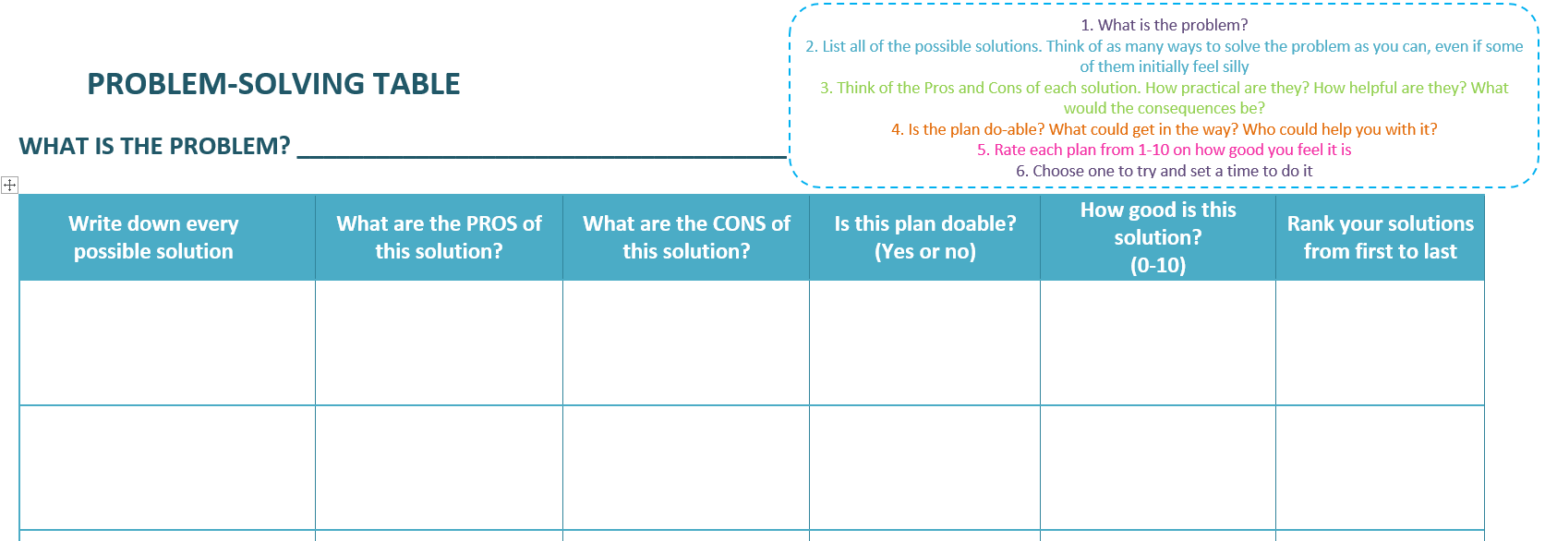
Problem solving worries
I haven’t practiced my spellings enough – going to get them all wrong
Notes:
E.G – I haven’t practiced my spellings enough, I’m going to get it all wrong
Solution – ask the teacher for help, practice at home, skip the test and then you don’t have to worry about it

Slide 15
Changing your responses
Cutting out reassurance:
  Children seek reassurance to help them feel comfortable and capable in anxious situations
  Constantly giving reassurance can become unhelpful – children become reliant on this and we can’t always promise everything will be okay!
Promote independent thinking:
  Ask your child what they think about the situation
  e.g. “what if they laugh at me??” – “what can you do if that happens?”
Encourage thought challenging:
Challenge your child’s thoughts to explore their worries by using questions like “has that happened before?” “what makes you think that’s true?” “is [x] likely to happen?”

Slide 16
Behavioural Difficulties

Slide 17


What are behavioural difficulties?
Behaviour that causes difficulties in multiple areas of the child’s life (home, school, friendships or other environments)
Behaviour that occurs again and again for several months or longer

Slide 18
What impacts behavioural difficulties?
Unclear boundaries
Ineffective consequences
Reinforced misbehaviour
Lack of consistency
Parent-child interactions
Personality
Development/special needs
Parent stress
Not going to school
Not seeing friends
Issues with money
Parent factors
Child factors
Loneliness
Family tensions
Staying indoors
Issues at school/work
Missing out on things
Health worries
Lack of routine
Loss or bereavement
Health worries
Social support
Loss or bereavement

Slide 19

What might behavioural difficulties look like in children?

Slide 20
Signs and symptoms of behavioural difficulties
Emotional outbursts (e.g. shouting, screaming, crying)
Physical outbursts (e.g. hitting, throwing)
Difficulties following routine (e.g. getting ready for school, getting ready for bed)
Difficulties following instructions
Difficulties with siblings or friends
Rude or stubborn
Attention-seeking behaviour

Slide 21

What keeps behavioural difficulties going?
    Attention rule: Children’s behaviour is often oriented towards gaining attention from others, especially parents
    Reinforcement rule: behaviour which is reinforced (focused on) immediately is more likely to occur
Notes:
https://www.youtube.com/watch?v=wBR5iUDeaWE&t=109s

Slide 22

Behaviour example
Jacob is in Year 2.
Jacob often struggles to follow instructions which means it is very difficult to get Jacob ready for school in the morning and to get him ready for bed at night. Jacob won’t do what Mum and Dad ask him to do, like putting his shoes on, and can throw his shoes or scream, even when they ask him to over and over again or get cross with him. Eventually Mum and Dad have to do these things for him.
Jacob also doesn’t play very nicely with his sister and Mum sometimes shouts at him. At school Jacob likes to make his friends laugh, but he is often told off by his teacher for his behaviour.
Notes:
ASK – what behaviour difficulties are present?

Slide 23
How can I manage my child’s behaviour?
Understanding behavioural difficulties
Limit setting and calm consequences
Goal Setting
Key Strategies
Used
Selective ignoring
Praise and rewards
Special time and positive attention

Slide 24
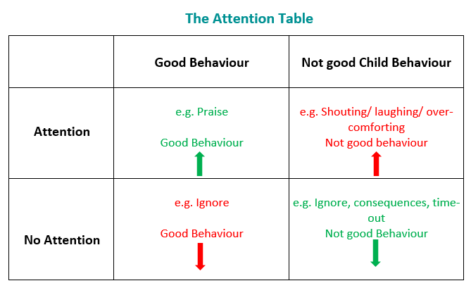
How can I manage my child’s behaviour?
Praise and rewards - increase attention for good behaviours, making it clear what behaviours you are happy with
Beware of the attention table- reduce attention for not so good behaviour and/or use other limit-setting strategies
Effective praise is:
    Specific
    Immediate
    Positive
    Sincere
    Enthusiastic
You and your brother did so well playing nicely together, I’m so impressed!
High fives!

Slide 25
Special Time
What is special time?
A time to play with your child for 10-20 minutes every day
The child will choose the activity and parents will follow their lead
The parent joins in fully with the play and gives the child their undivided attention for the entire time
It allows parents to form positive memories and build a strong relationship as a foundation for dealing with more difficult times
Do: give your full attention, allow the child to lead, show interest/empathy, give a warning when it is about to end
Don’t: take charge, give commands, ask questions, teach, compete or criticise

Slide 26

How do we know if our child’s anxiety or behaviour has become a ‘problem’?
Everyone feels anxious or might have an emotional outburst in response to a particular event
When do we know if there is a problem?
    If it happens frequently
    If it lasts for a long time
    If the worry or behaviour is intense/disproportionate
    If it impacts you or your child’s life
    (home, school/work, social/leisure activities)

Slide 27
What can you do if you are concerned about your child?
Try some strategies:
Reward chart at home
Praising brave or positive behaviour
Set routine/structure at home that is agreed with their child
Set some goals and review them weekly
Attend further workshops with the MHST
E.g. behaviour specific workshop - further tips and techniques for parents to use at home
Make suggestions using the survey monkey feedback
Talk to your child’s teacher or school link worker if you feel support from the MHST is necessary
Talk to your child’s GP – referral into CAMHS

Slide 28
Support from a Wellbeing Practitioner at the MHST
Speak with school link worker or your child’s class teacher to share your concerns
Request a referral be made to the MHST
A Wellbeing Practitioner will invite you for an assessment session to explore the issues raised and assess whether the MHST is the best service to support you
You could be offered:
  6 sessions of guided self-help for child anxiety (focussing on managing worries and facing fears)
  7 sessions of guided self-help for challenging behaviour (focussing on building the parent-child relationship, increasing positive attention, setting boundaries and consequences
  Spaces are limited – subject to a waiting list

Slide 29
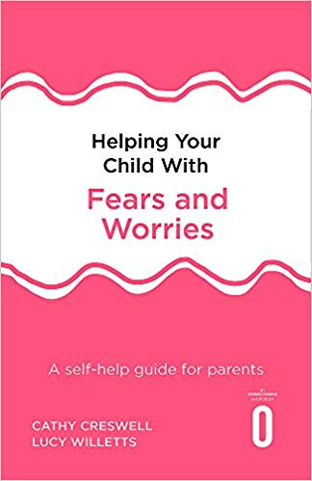

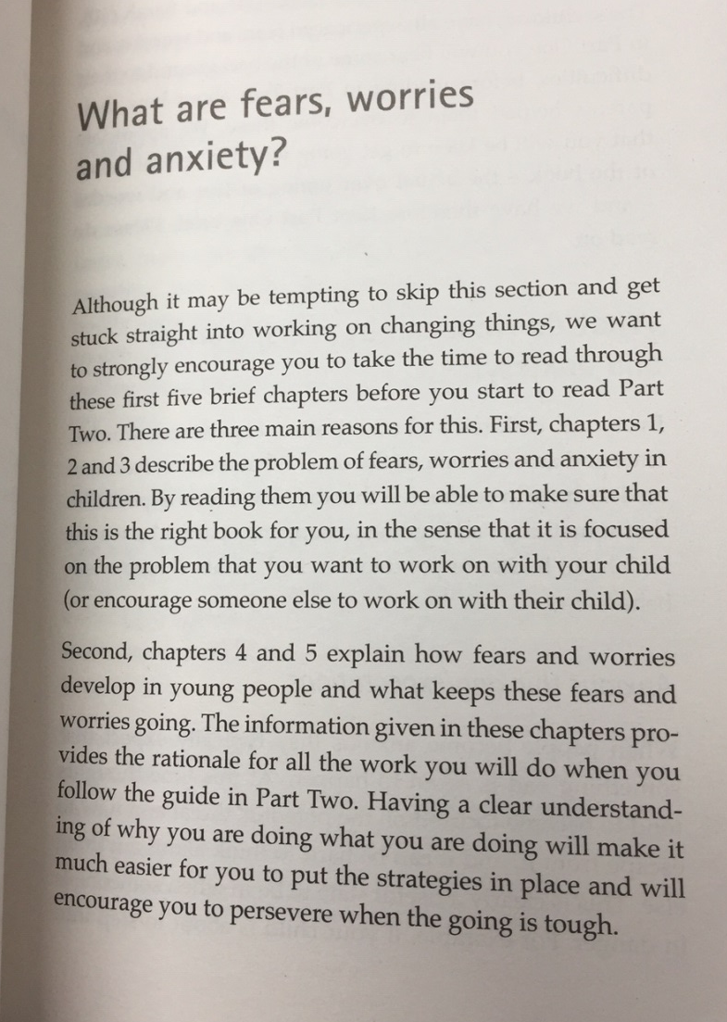
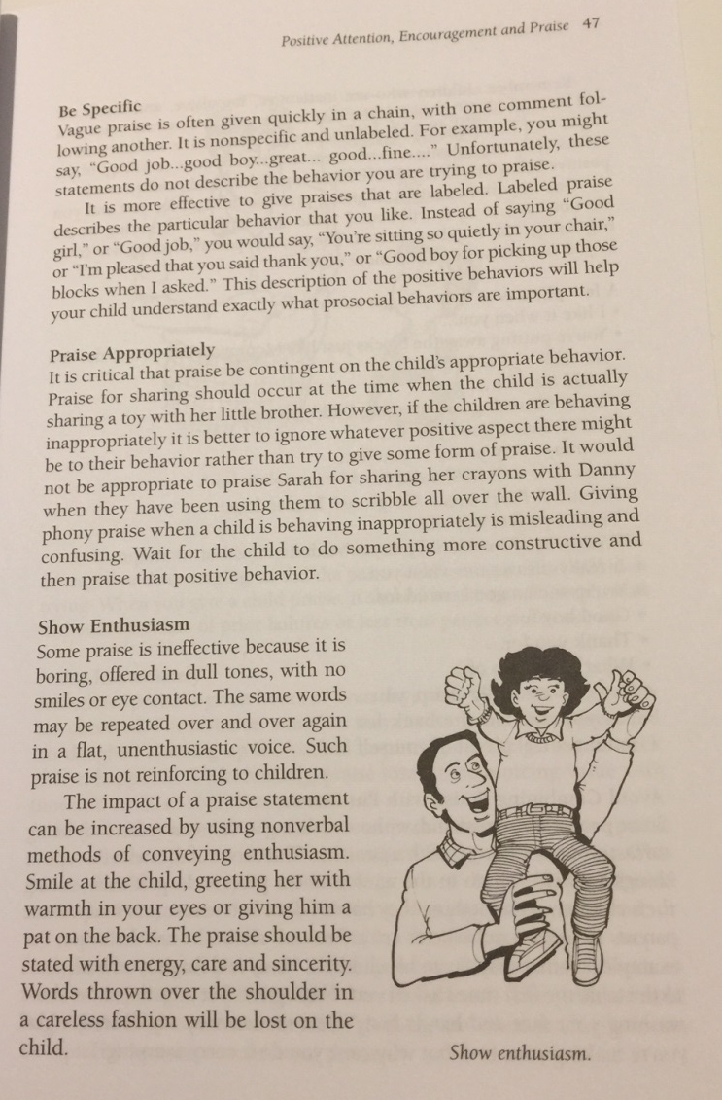
Further support: Books
You can buy this self-help guide online
e.g. Amazon.co.uk or ebay.com
You can buy this self-help guide online
e.g. Amazon.co.uk or ebay.com

Slide 30
Further support in general
Anxiety UK
https://www.anxietyuk.org.uk/
Information, resources and support for helping you understand how to deal with your anxiety during these difficult times.
Hope Again https://www.hopeagain.org.uk/
Hope Again provides support, advice and information to children, young people and adults when someone close to them dies.
Childline https://www.childline.org.uk/
A free and confidential support service for children. Childline is here to help anyone under 19 in the UK with any issue they’re going through.
Young Minds www.youngminds.org.uk
Information for young people and parents about emotional and mental health issues.
MIND https://www.mind.org.uk/
Call, text or email for signposting to mental health support in your area.
Anna Freud
Parents and Careers | Advice and Guidance | Anna Freud Centre
Advice and guidance for parents and carers to help them support a child or young person with their wellbeing

Slide 31

Thank you for listening!

