Slide 1

Reception Parents/Carers workshop
Nurturing young writers from mark making to writing.

Slide 2
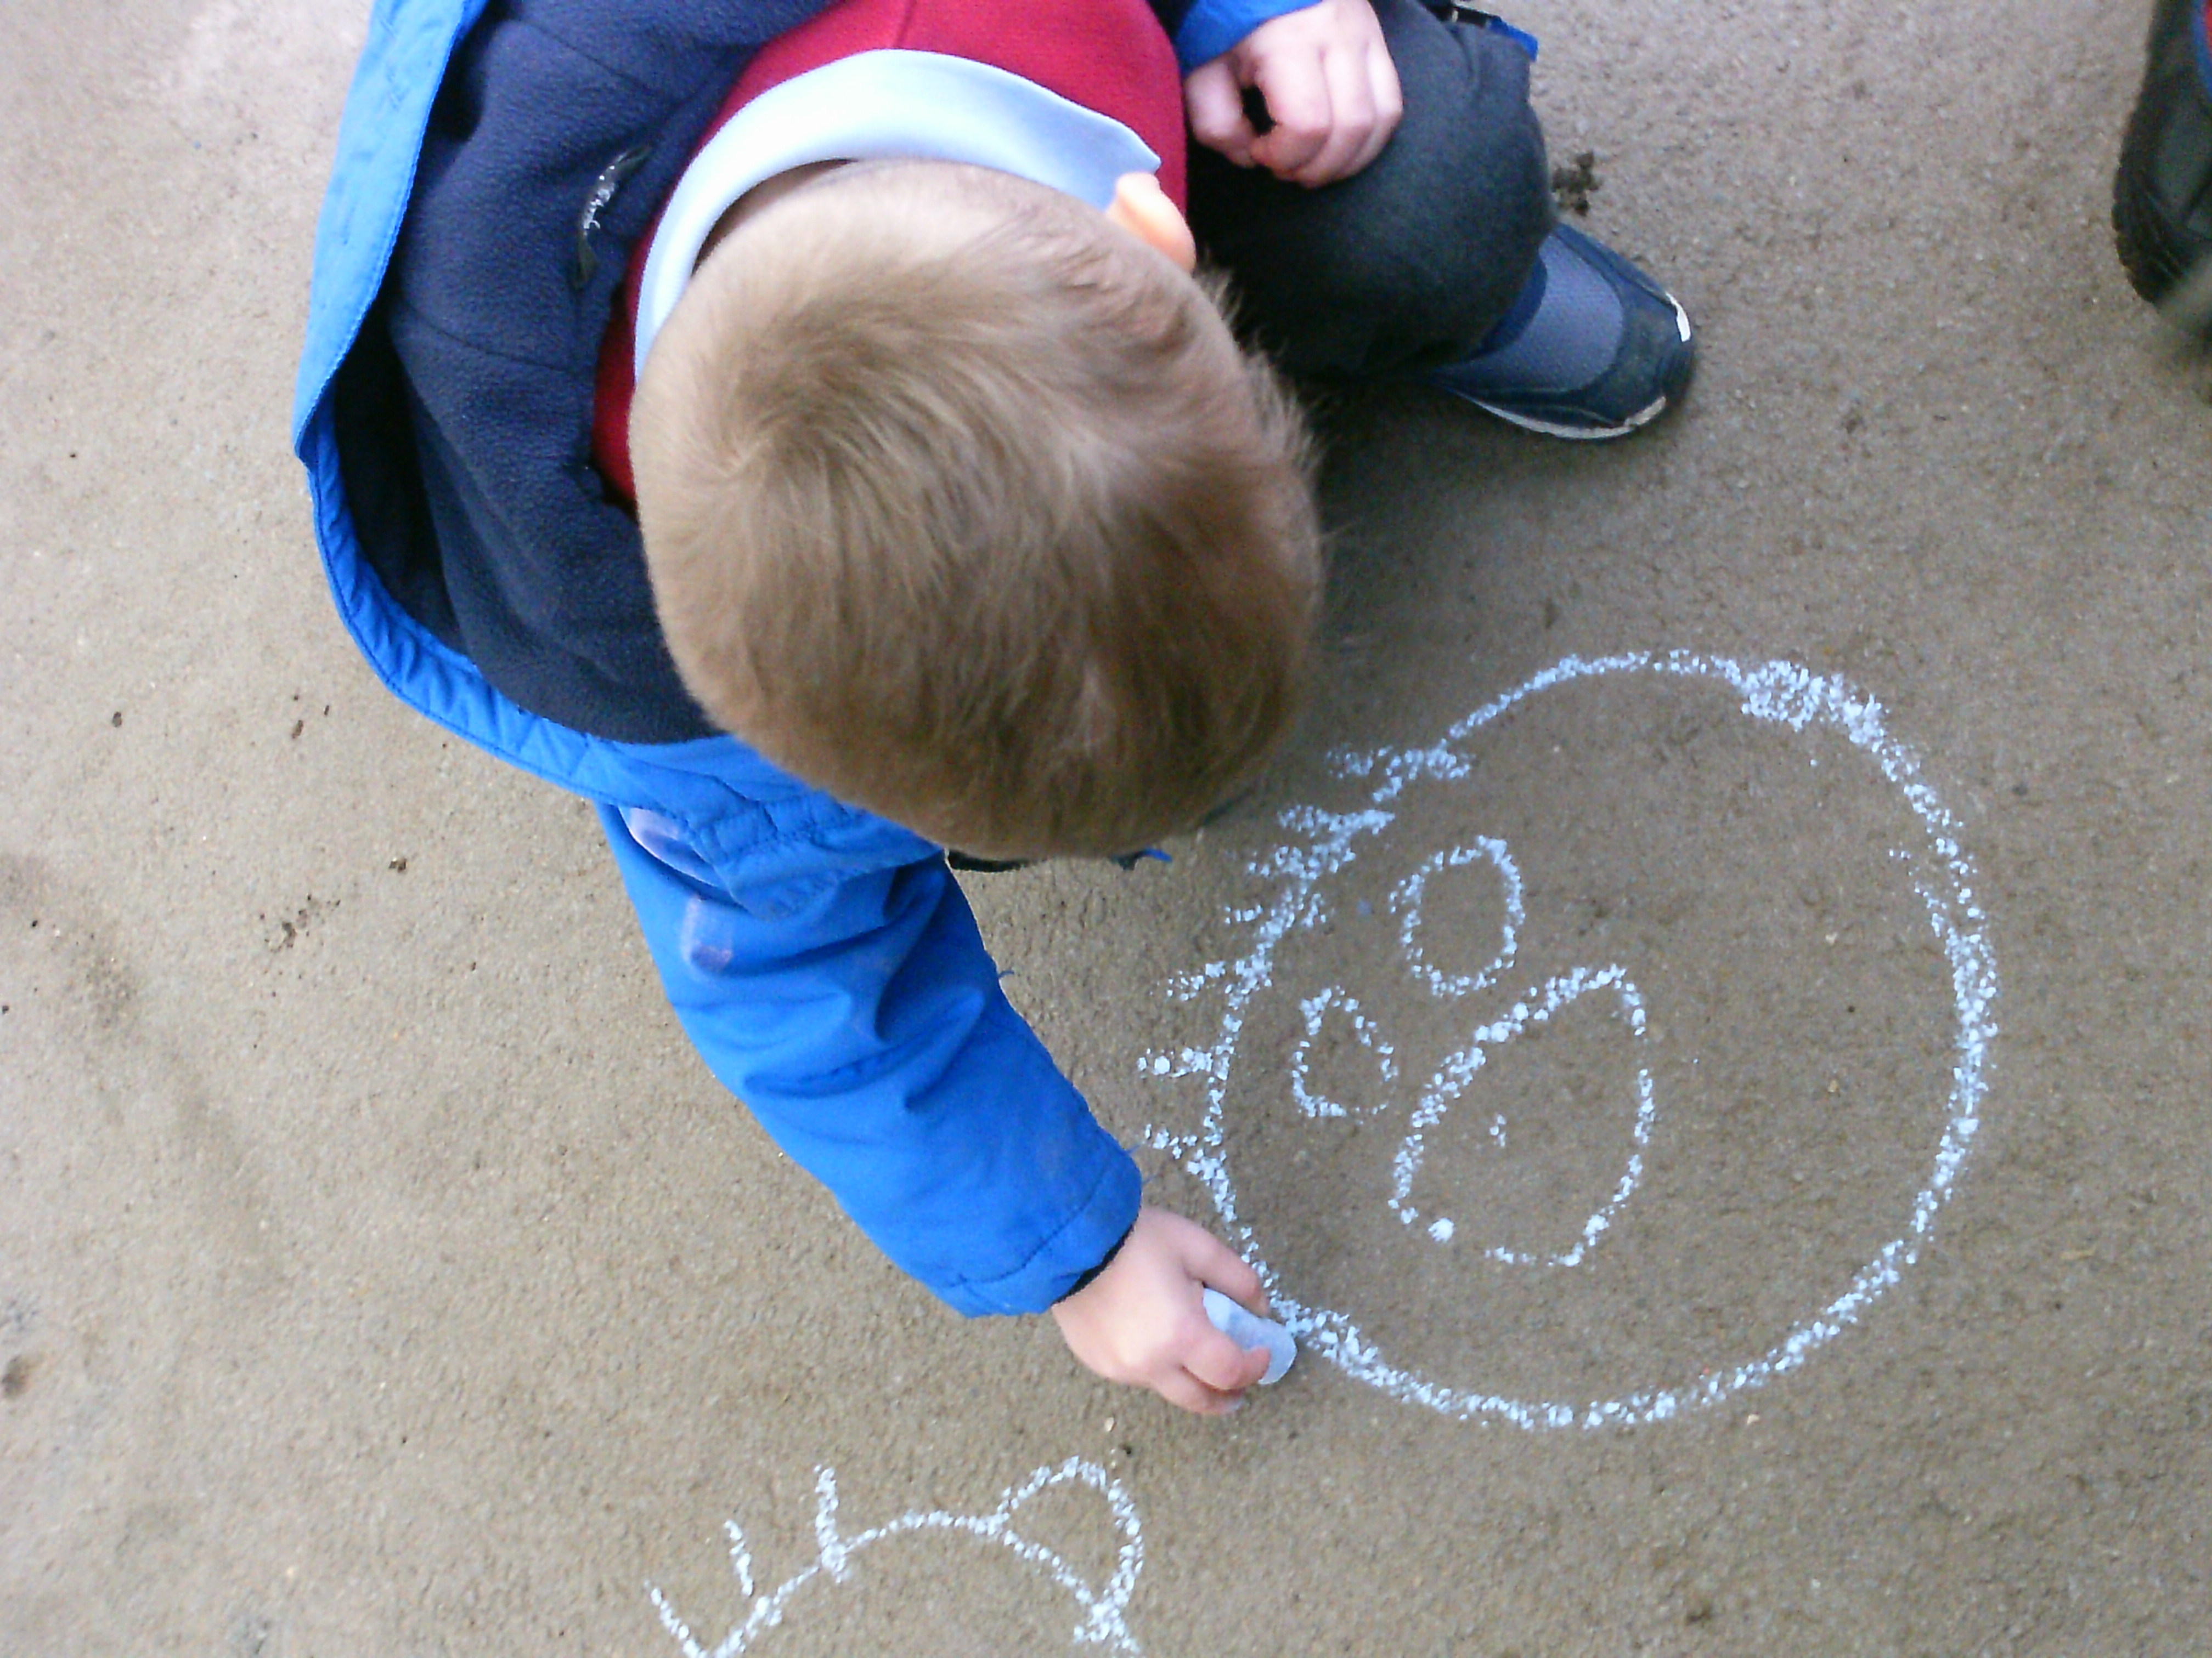
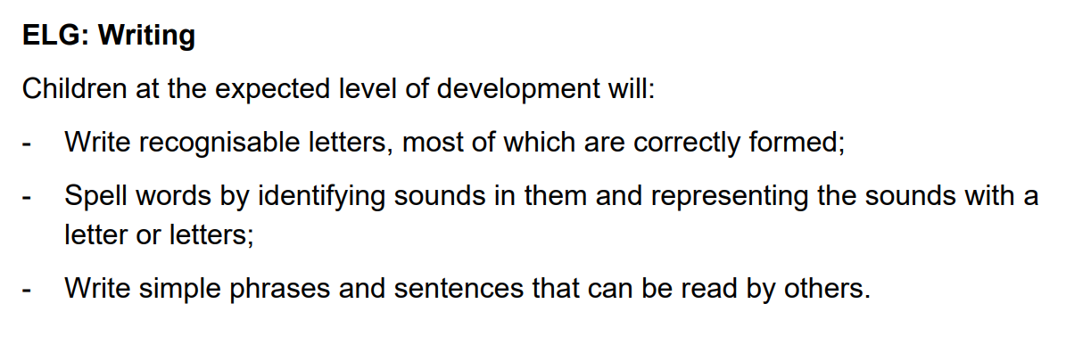
What are we working towards?
Writing - ELG

Slide 3
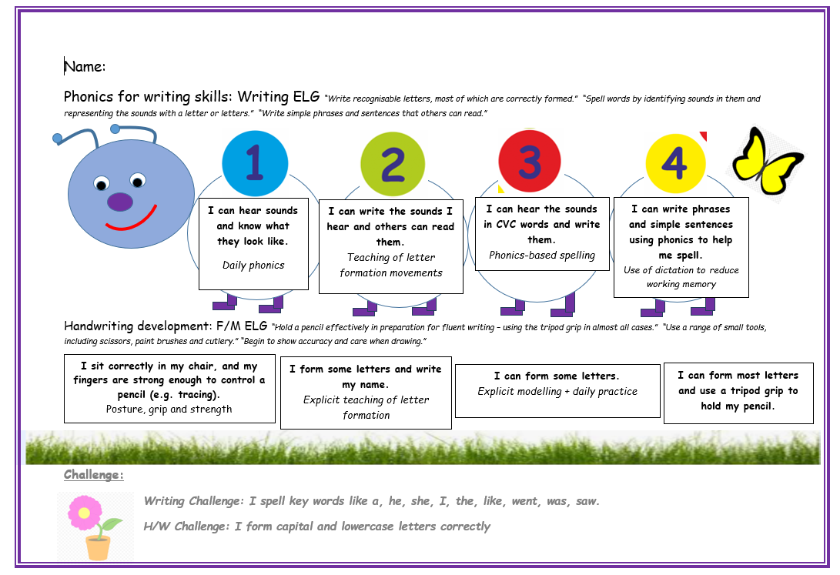

Slide 4
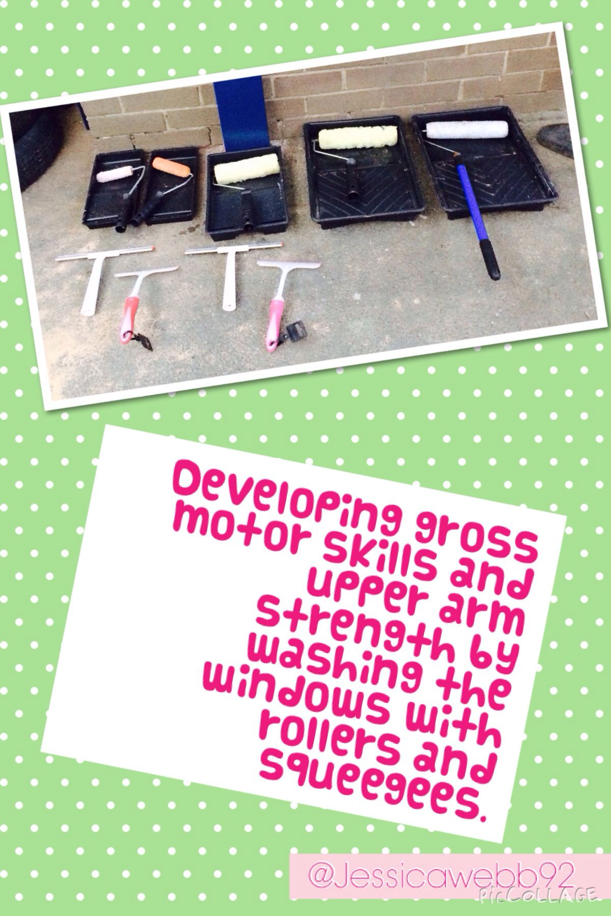
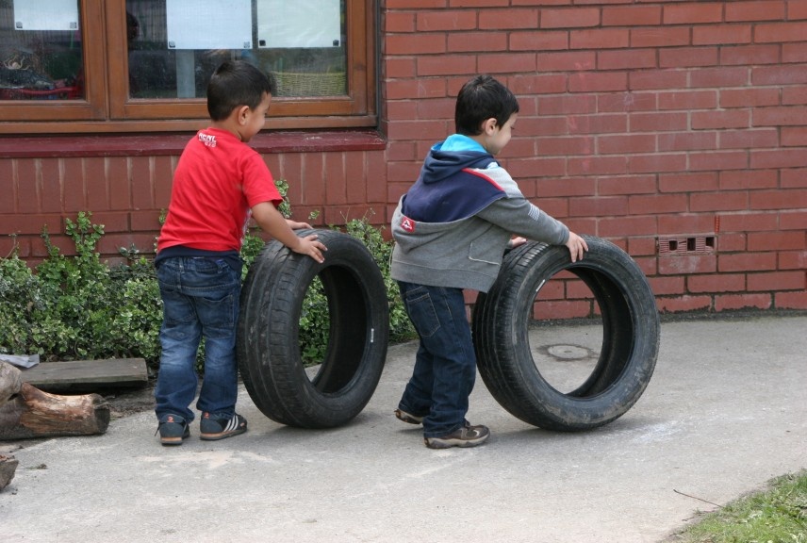
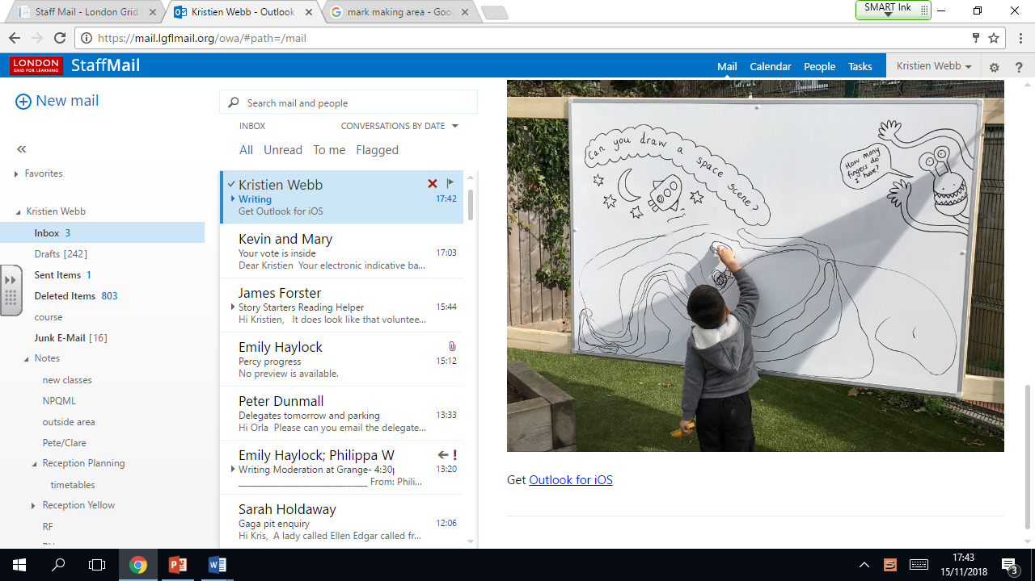
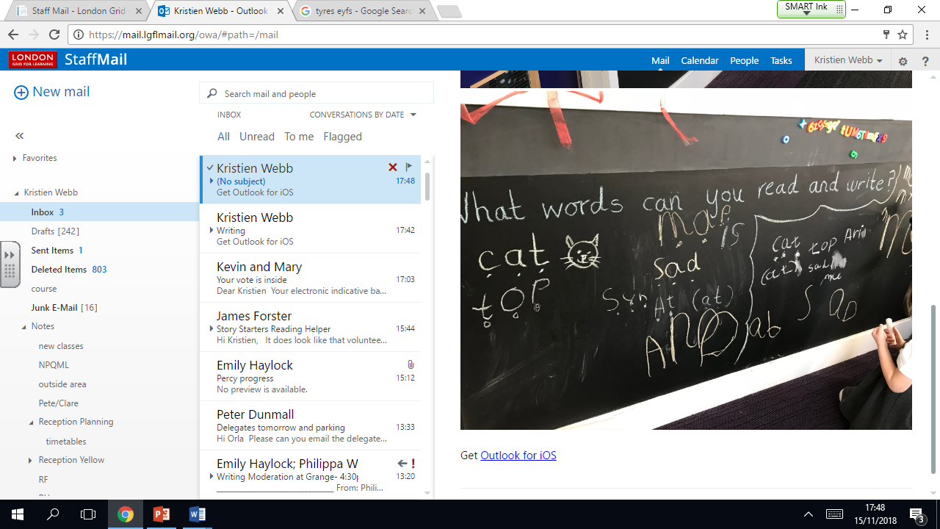
Developing Gross motor skills

Slide 5
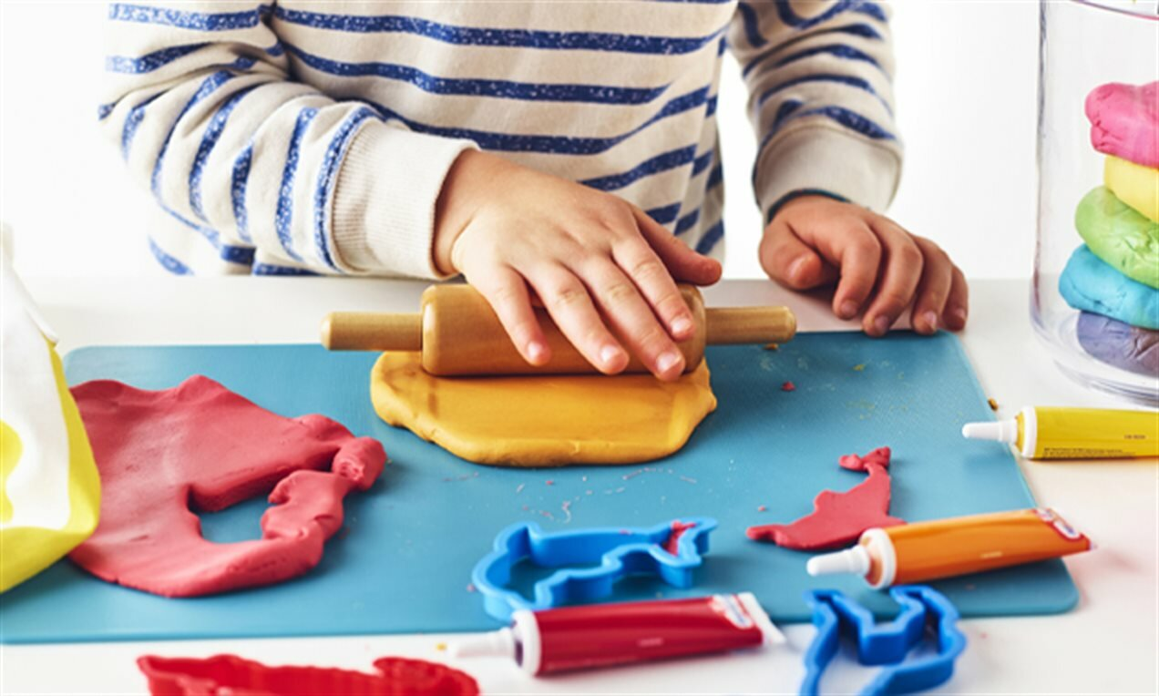
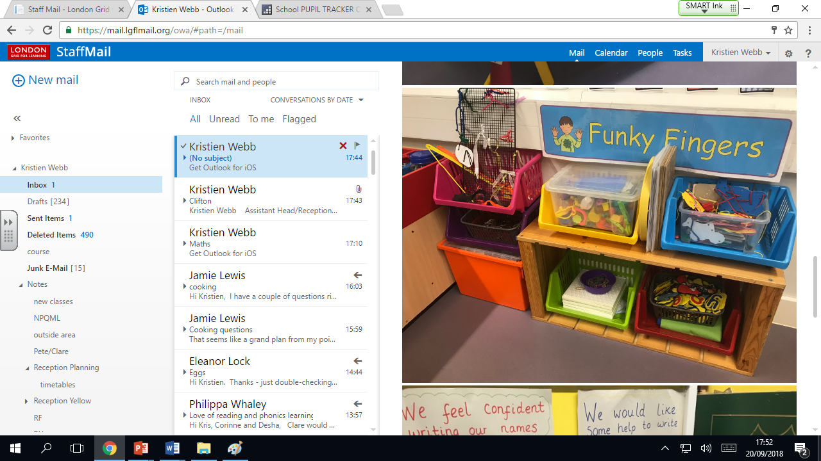
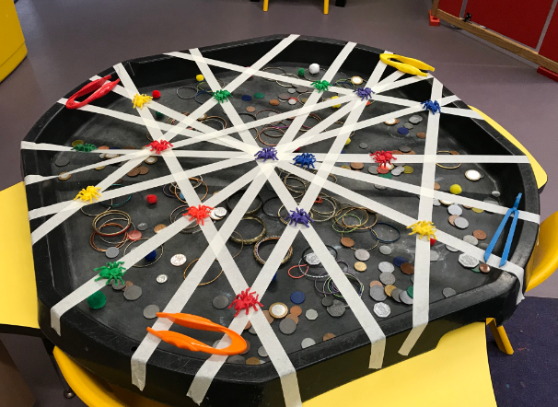
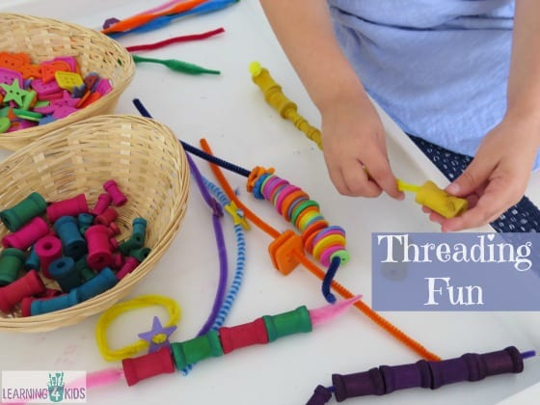

Funky Fingers – developing fine motor skills

Slide 6
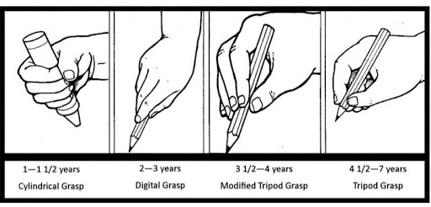
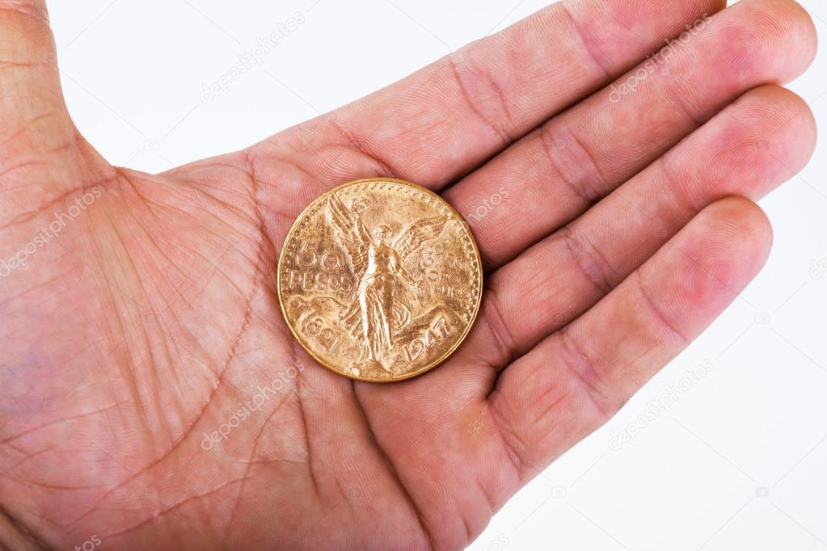
Funky Fingers – developing fine motor skills

Slide 7
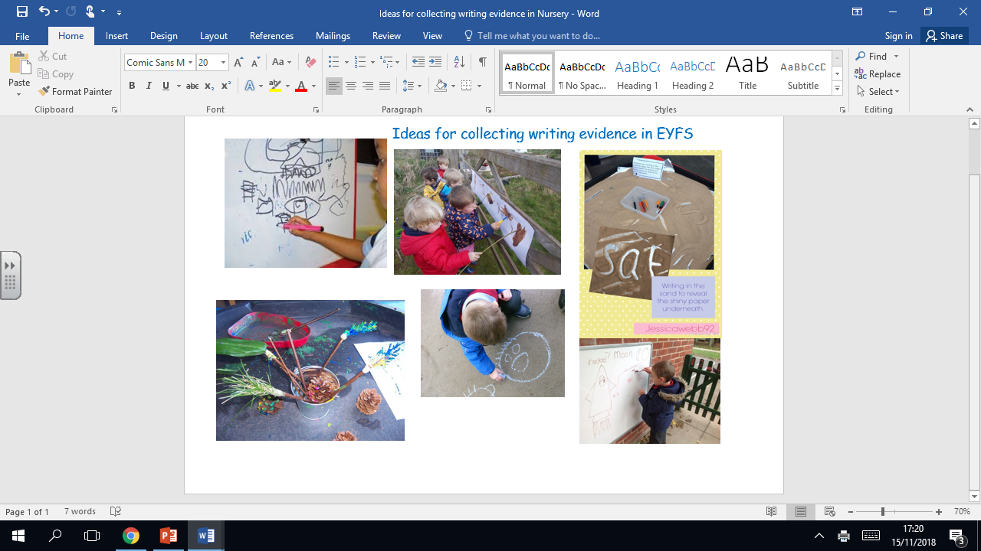

Slide 8
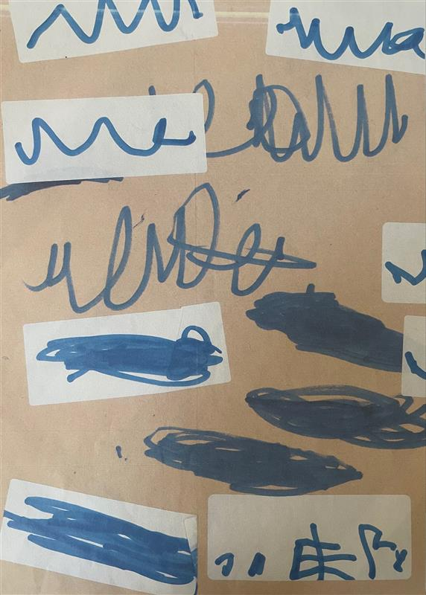
Mark Making
Important stage in development
Encourage children to talk about the marks they have made
Questions – What is this?
Shower with praise – develop confidence to believe they be a writer

Slide 9
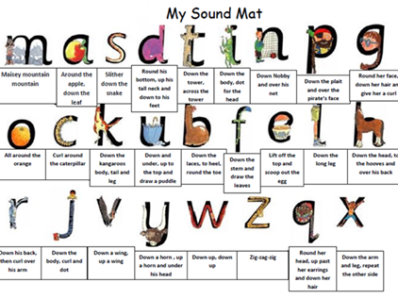
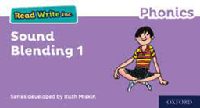
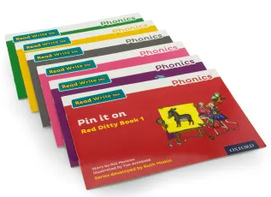

Read Write Inc Books/Activities and the links to writing
My Phonics book
Phonic activities
(first 10 phonemes)
Sound blending

Slide 10
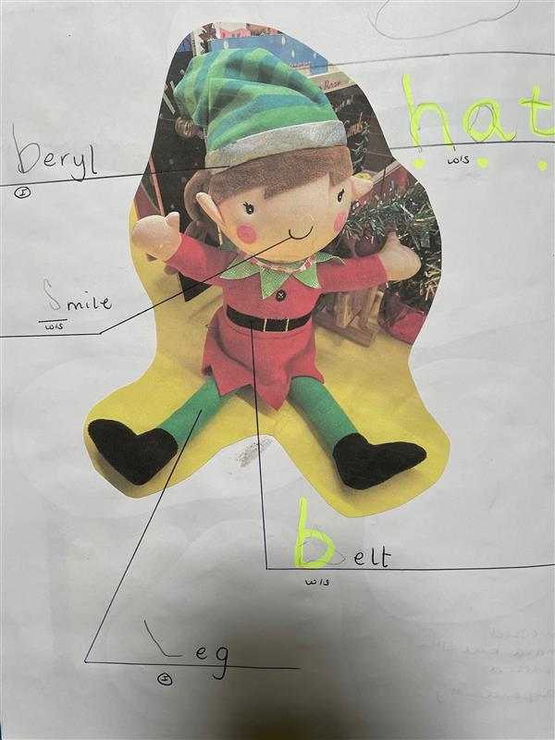


Writing the Initial Sound in words
Say it – say the word
Think about it - what is the initial sound?
Model it – Freddie Fingers (yours, theirs)
Write it – write the sound
Support – adult writes the rest

Slide 11
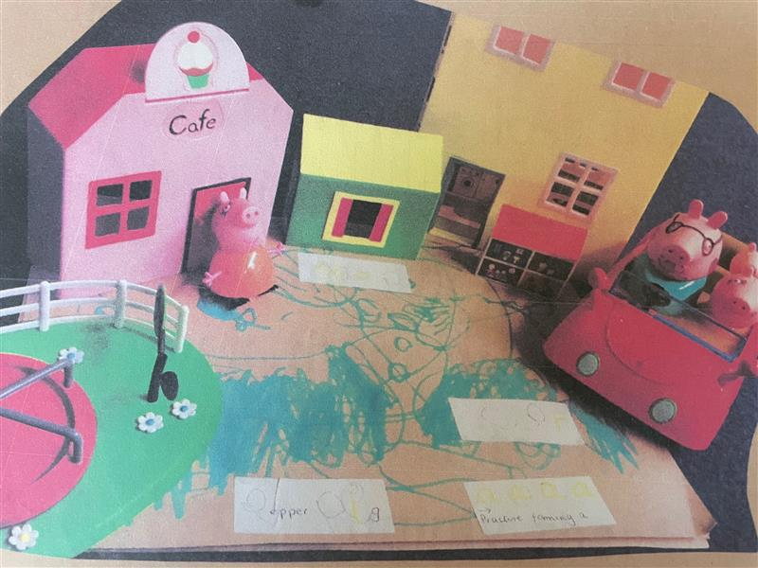
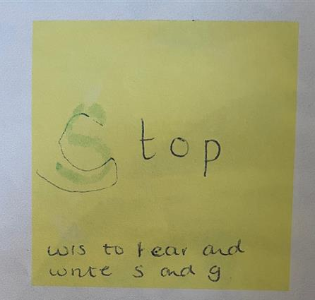
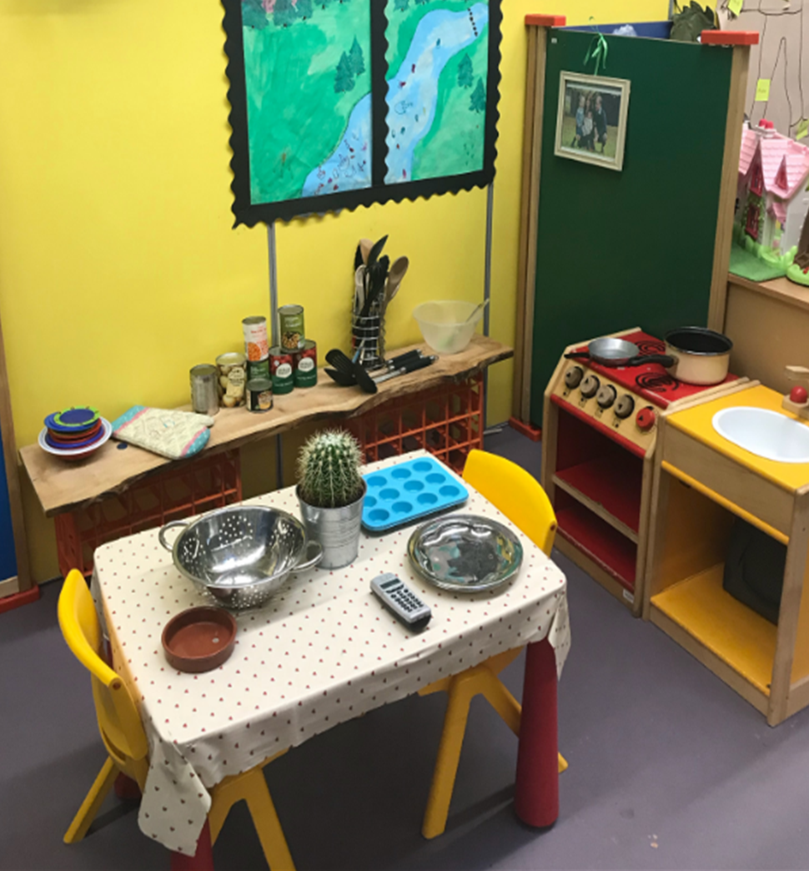
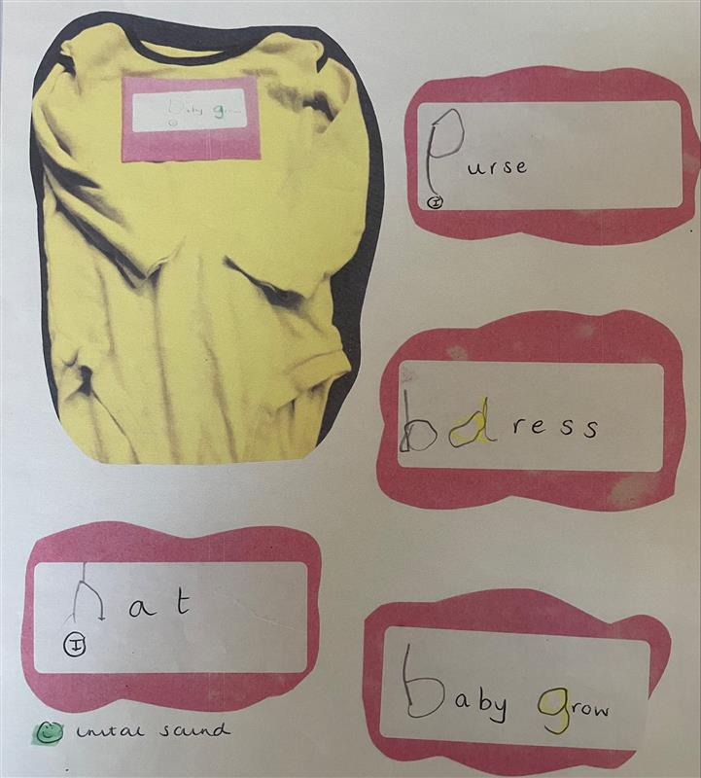
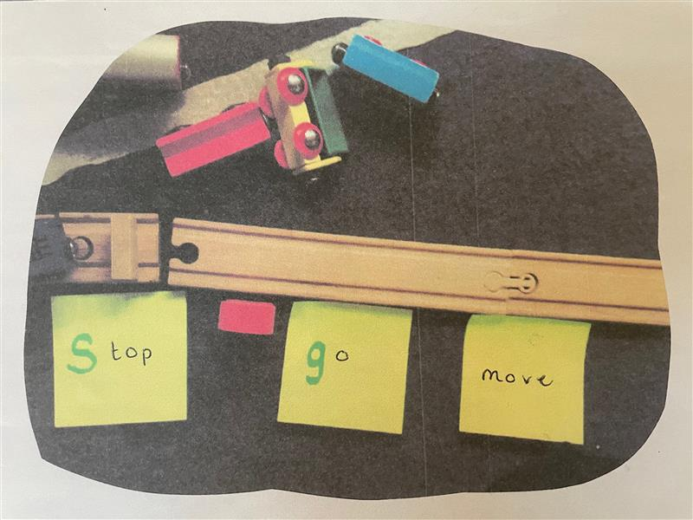
Writing the Initial Sound in words

Slide 12
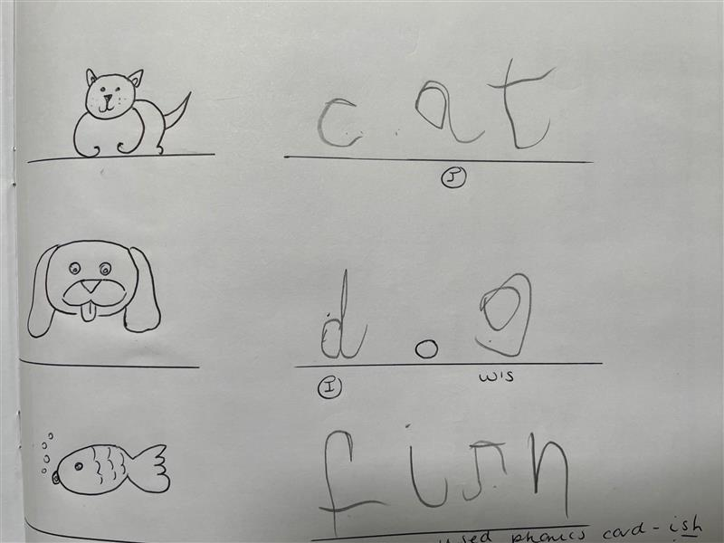
Segmenting and Blending words
Say it – say the word (choose words they will be able to sound out)
Think about it - what is the initial sound? What sound comes next?
Model it – Freddie Fingers (yours, theirs)
Write it – write the sound
Support – adult writes what child cannot do

Slide 13
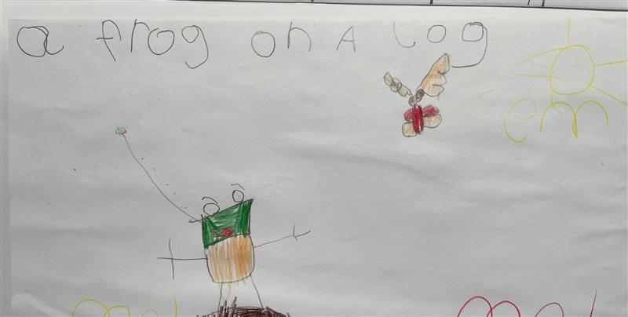
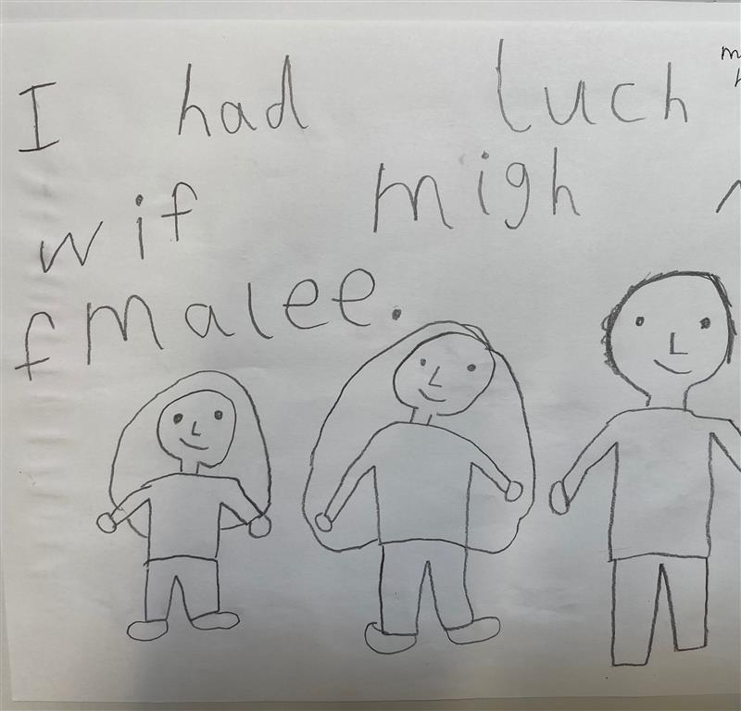
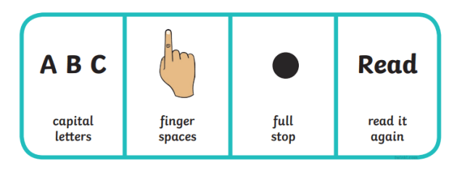
Writing Simple Sentences

Slide 14
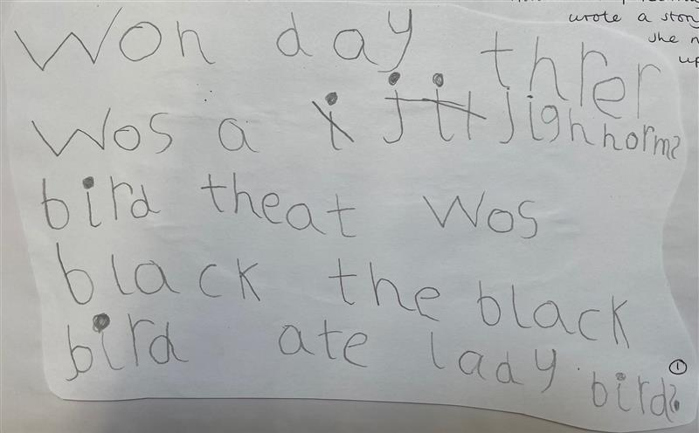
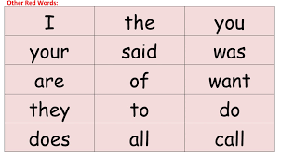

Writing Simple Sentences
Remind – what does a sentence need to contain?
Say it – say the sentence
Count it – count how many words in your sentence
Think about it - what is the initial sound? What sound comes next?
Say the first word
Model it – Freddie Fingers (yours, theirs)
Write it – segment and blend each word
Support – adult writes what child cannot do
Read it back – check for clarity
Click Moment

Slide 15
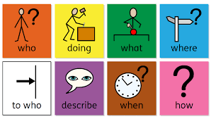
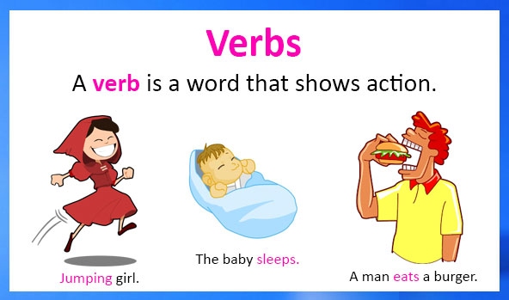
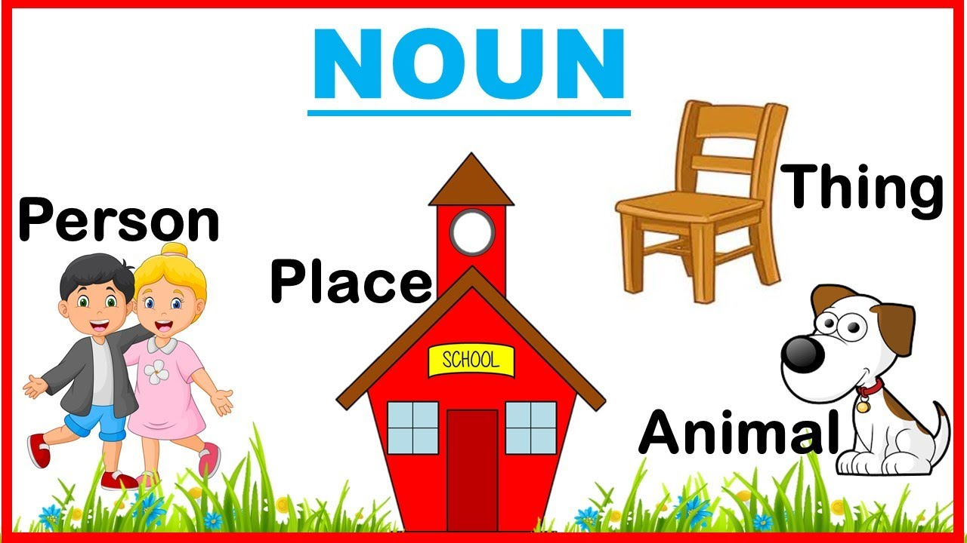
Understanding how to create a sentence
Colourful semantics
Reception – focus on who and what doing.
Sentence = verb and a subject (noun)

Slide 16
Tips for supporting writing at home
Be led by children’s interests (higher engagement levels)
Praise – helping our children know they are writers (display their writing)
Support – we can write together – children can only use sounds they have learnt (phonics, key word lists will support this)
Correcting a child – one focus at a time (highlighter pen)
Send work to school – develop a sense of pride/engagement
Make writing fun – through play, personalise, form of communication

Slide 17
Thank you for joining us today

