Slide 1

Reception Parents/Carers Workshop
The importance of early reading and our approach to phonics

Slide 2
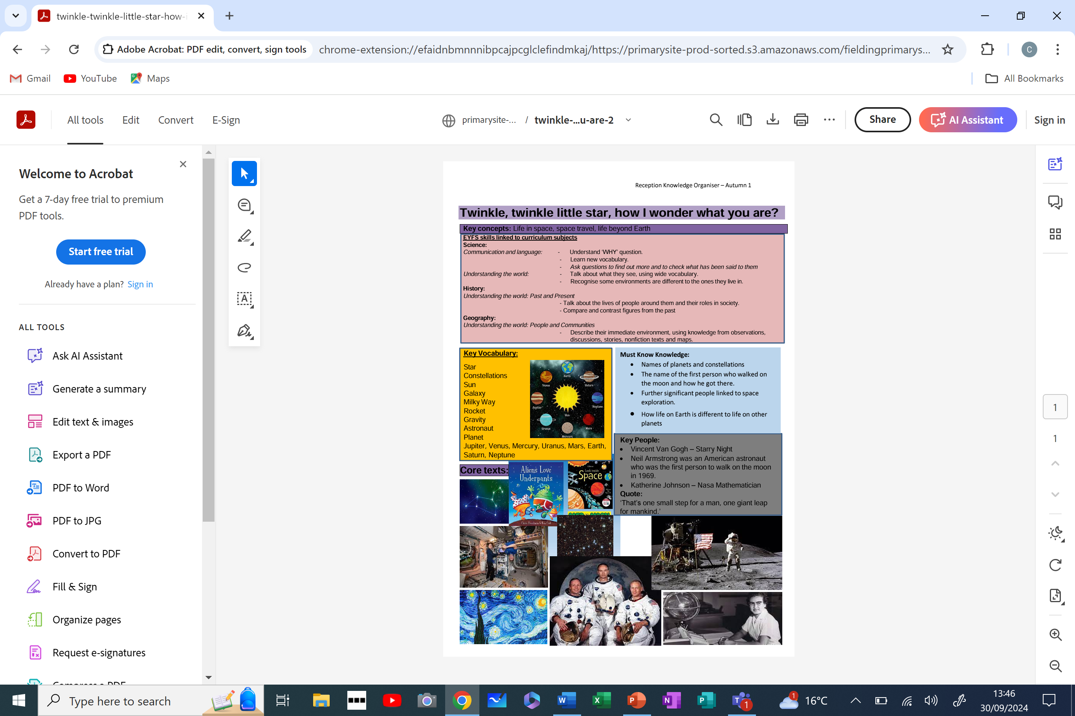
A day in the life of a Reception child at Fielding

Slide 3
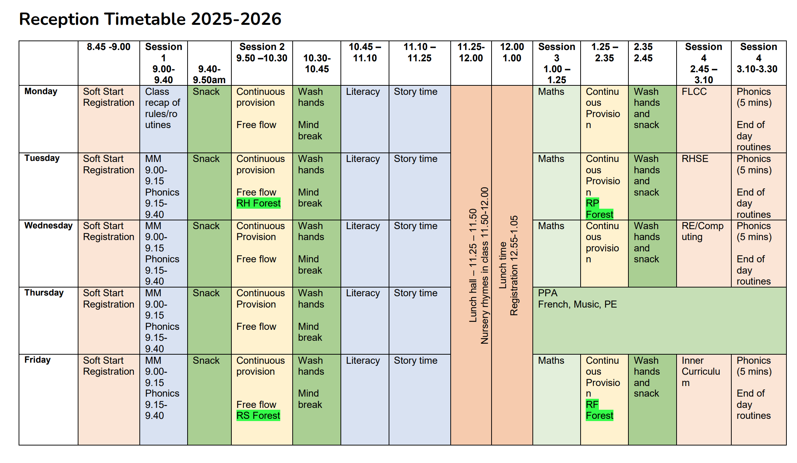

Slide 4
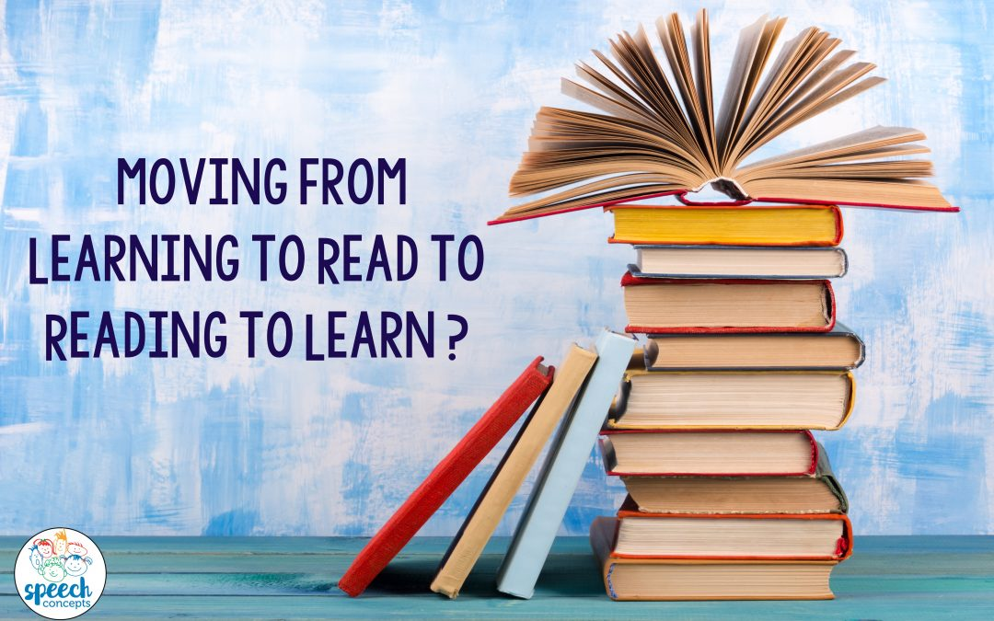
Early Reading
“There is more to reading than phonics - but there is also a weight of evidence that systematic synthetic phonics, taught in the first years of a child’s education, gives children key building blocks they need to understand words, underpins children’s attainment of a good standard of reading and can inspire a lifetime love of reading.”

Slide 5
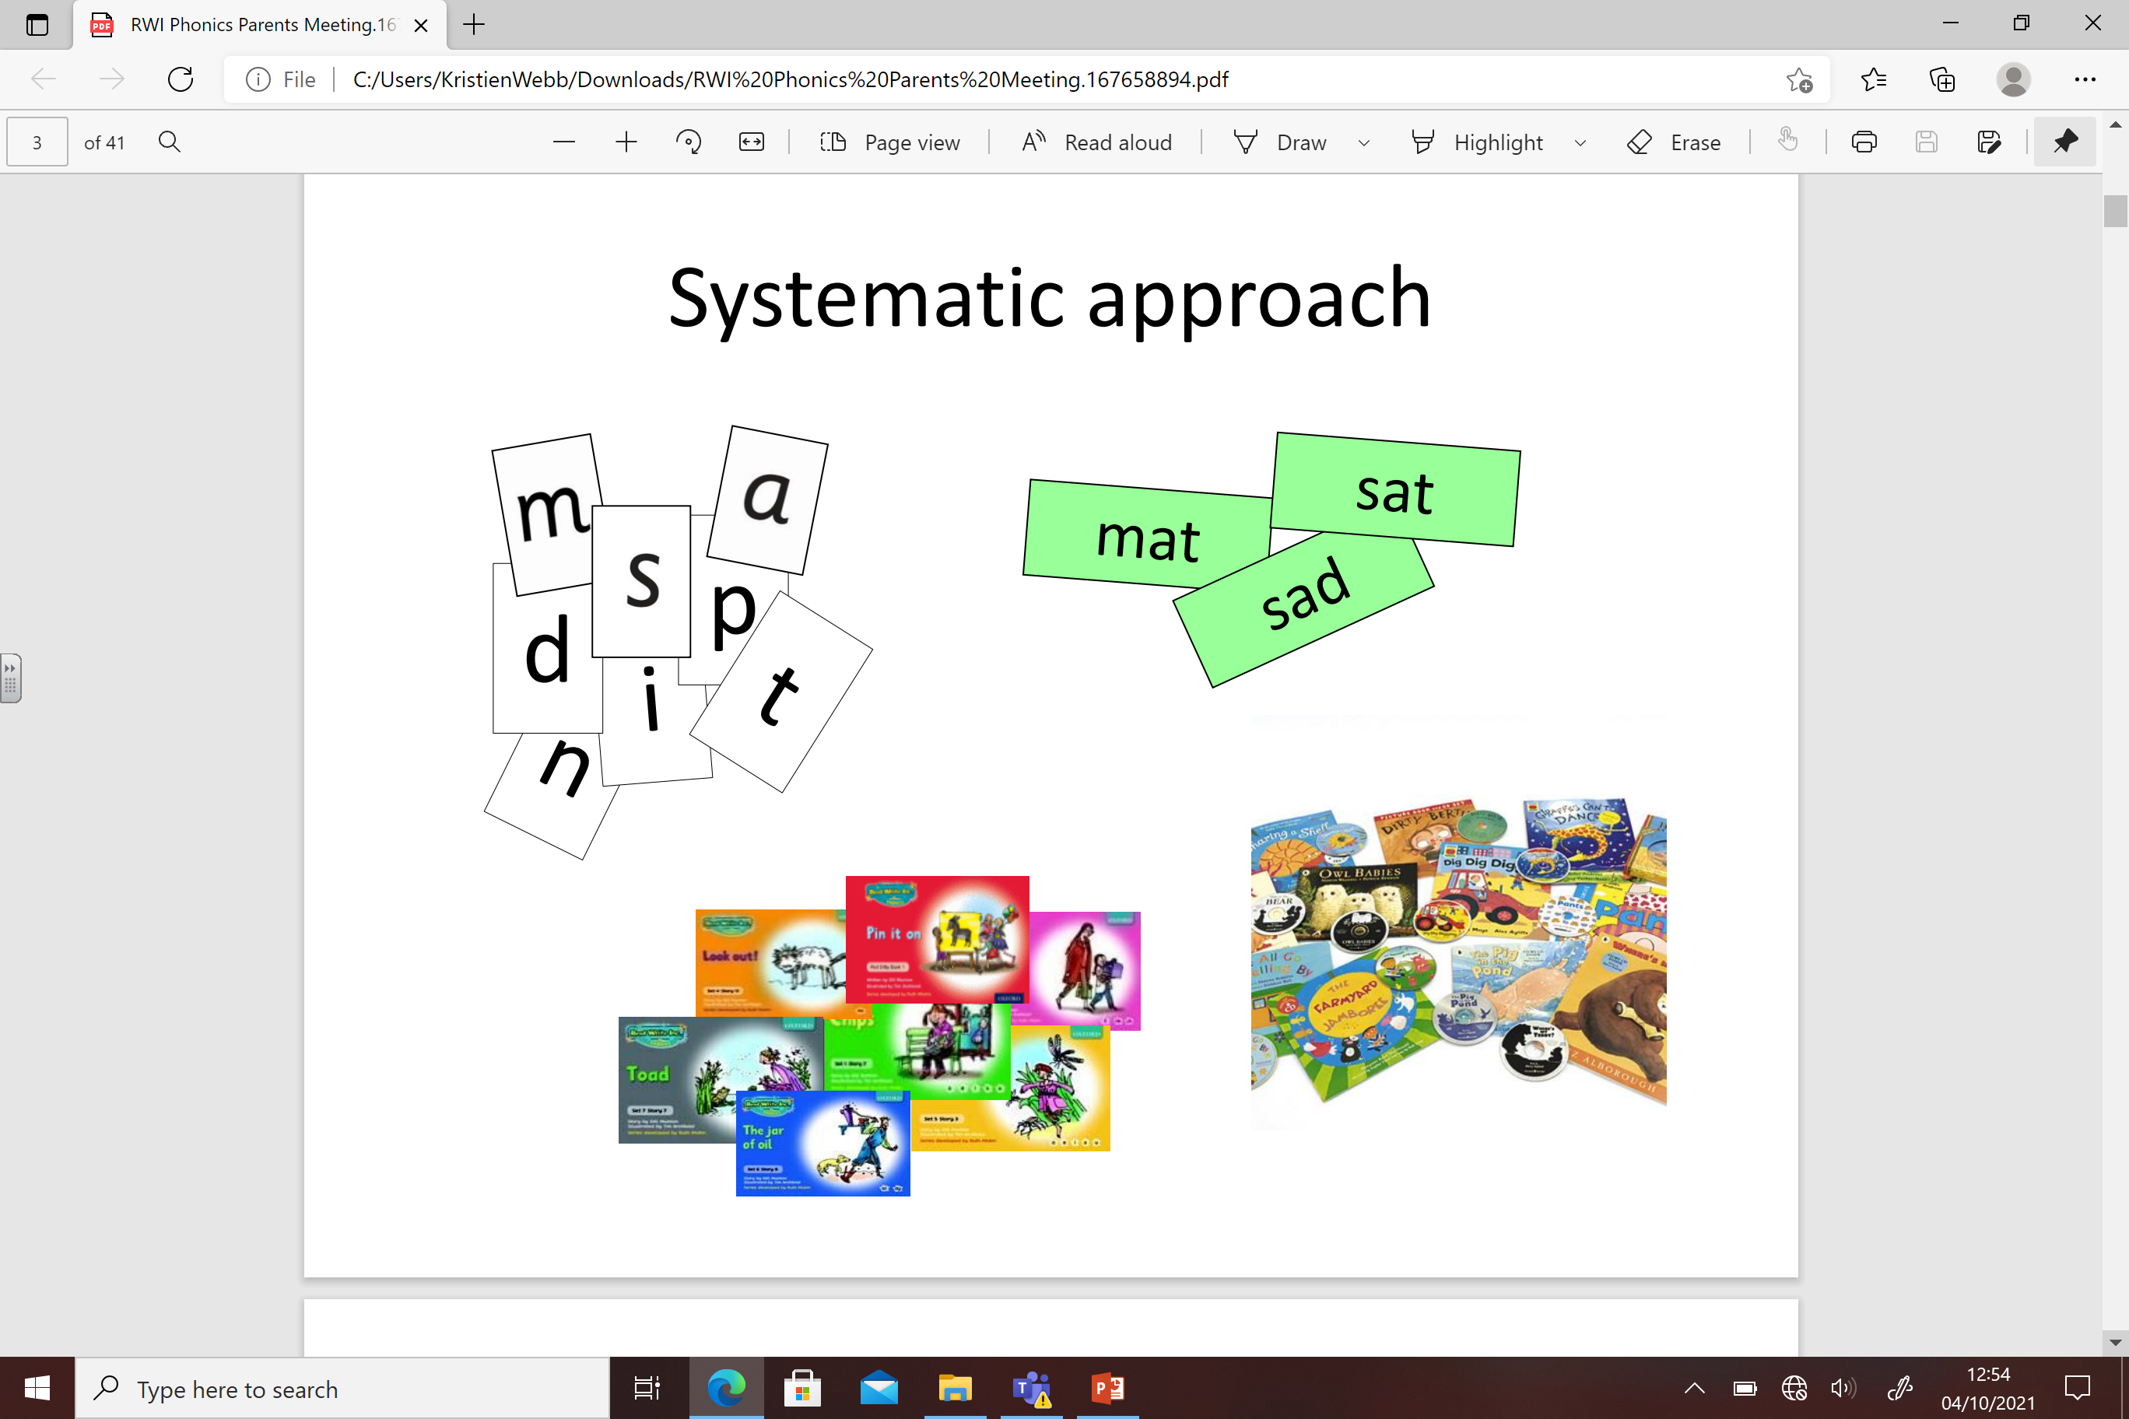


Slide 6
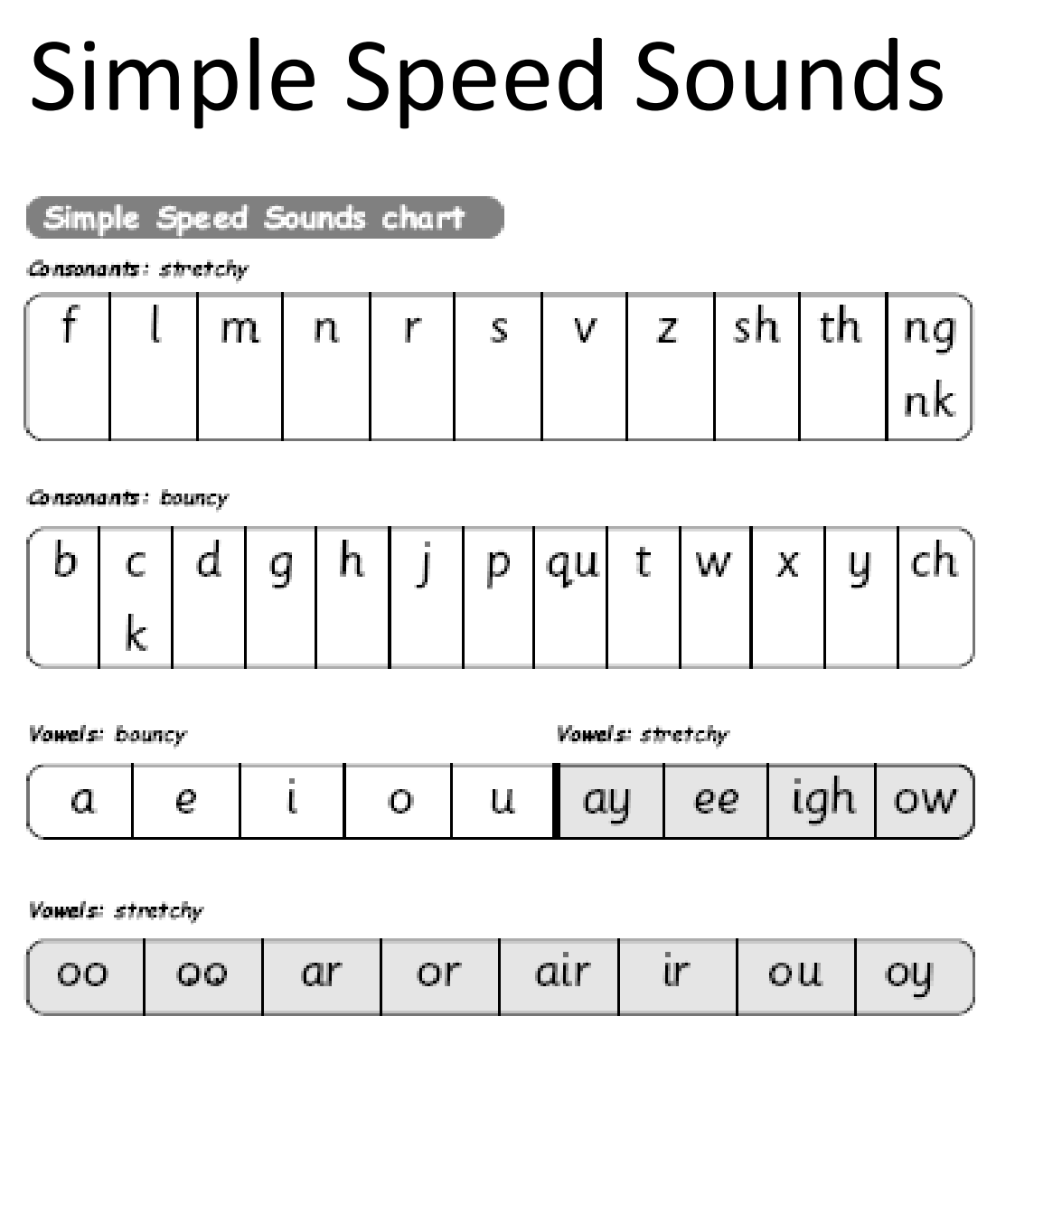

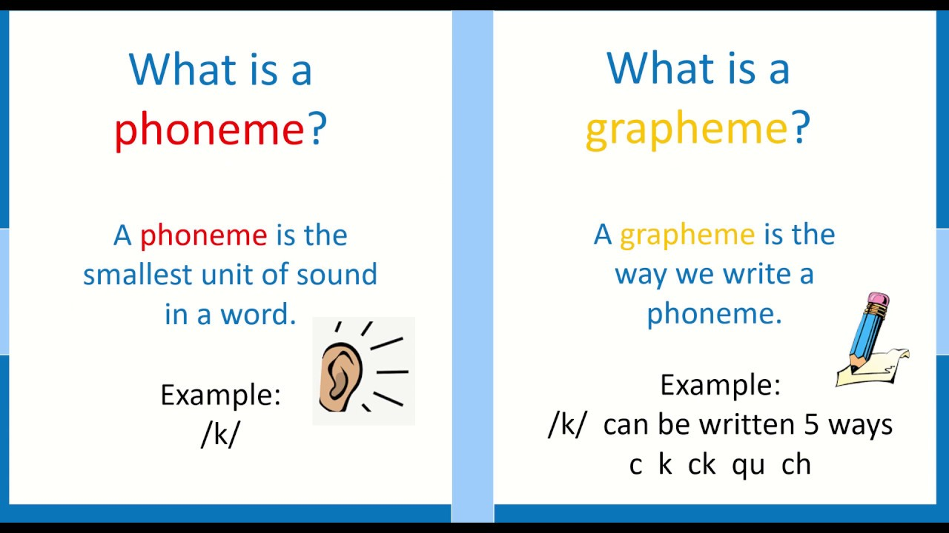
Children start by learning the simple speed sounds first.

Slide 7
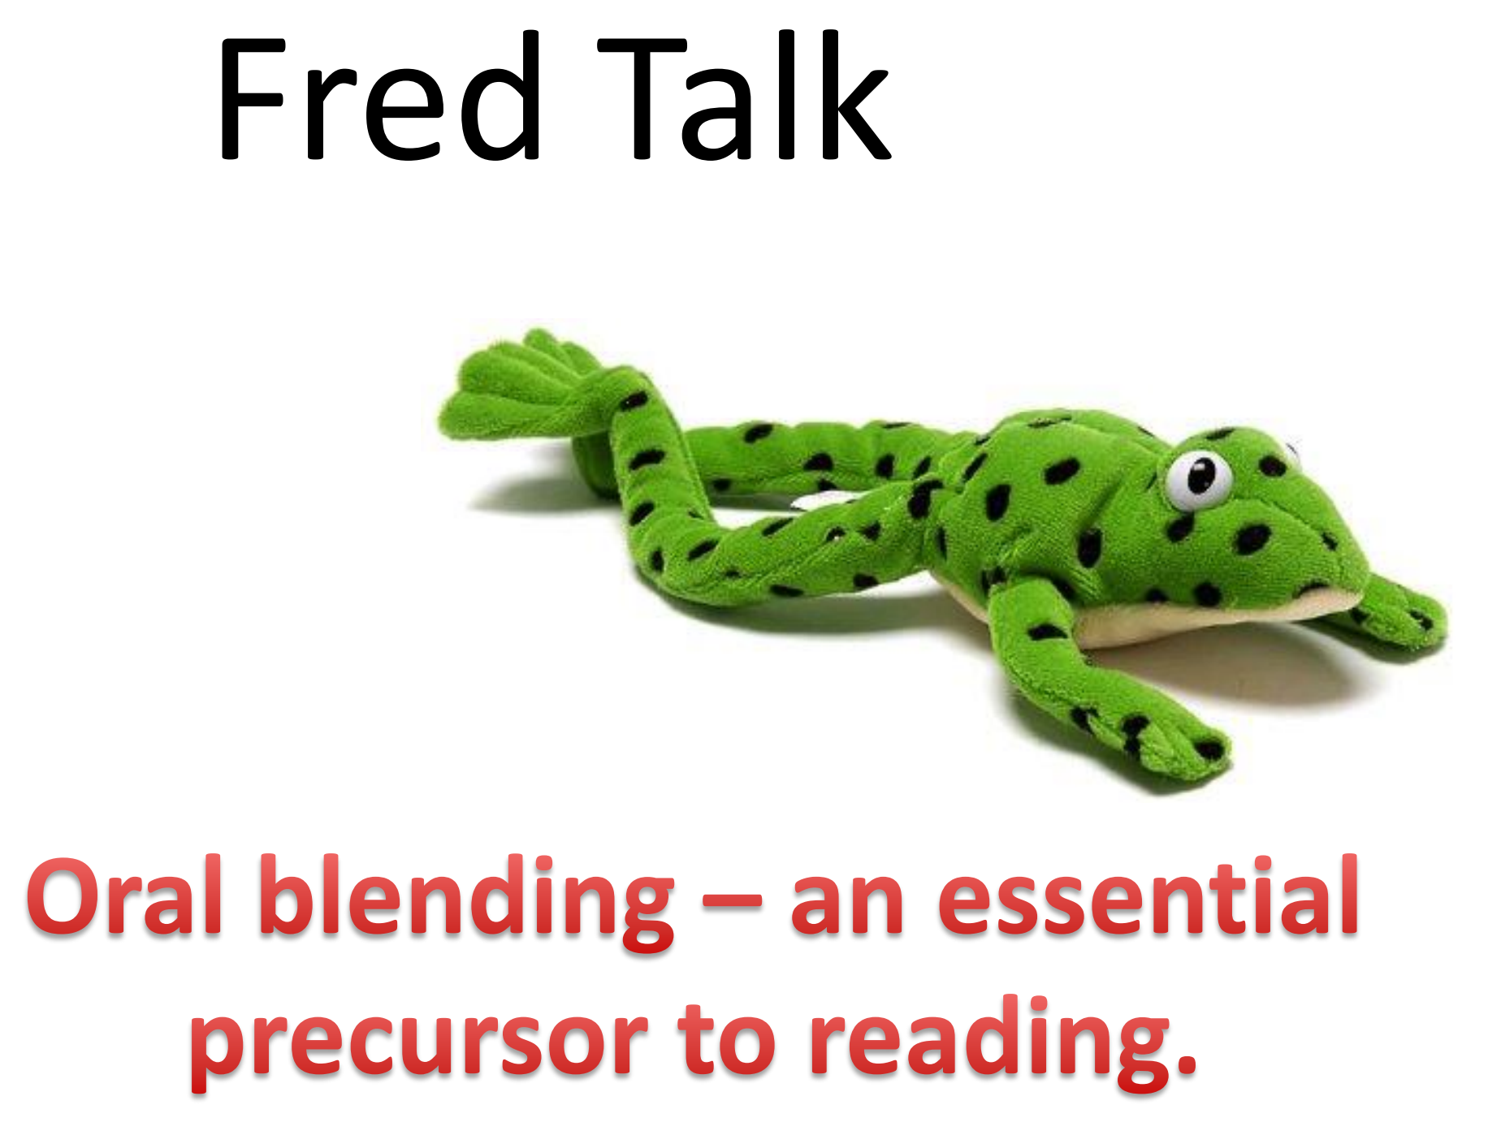

Slide 8
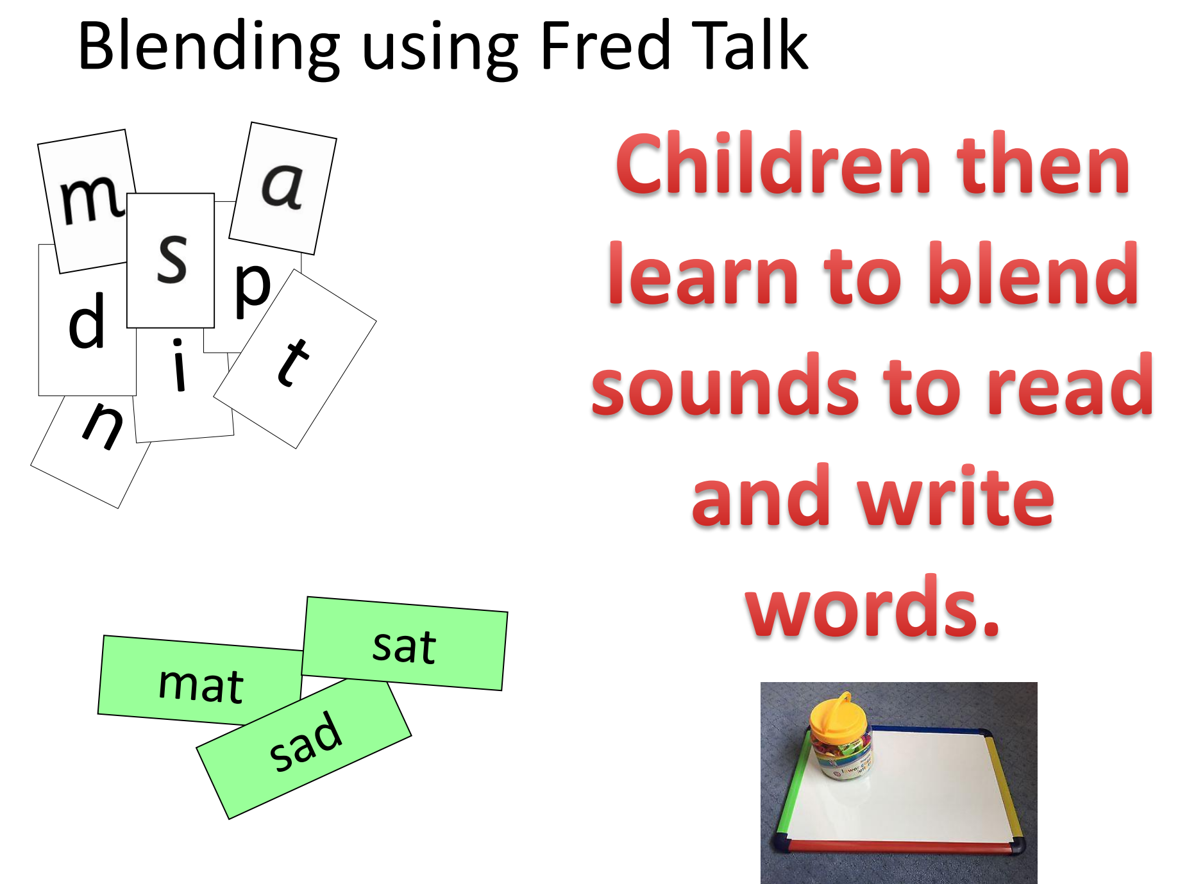

Slide 9
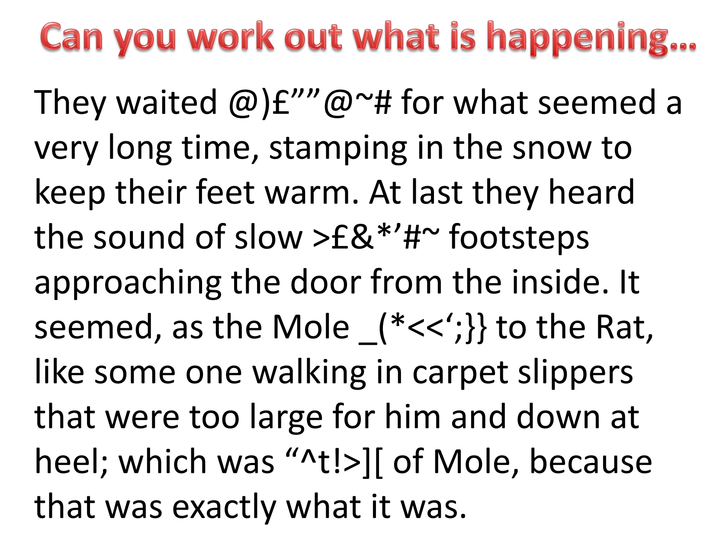

Slide 10
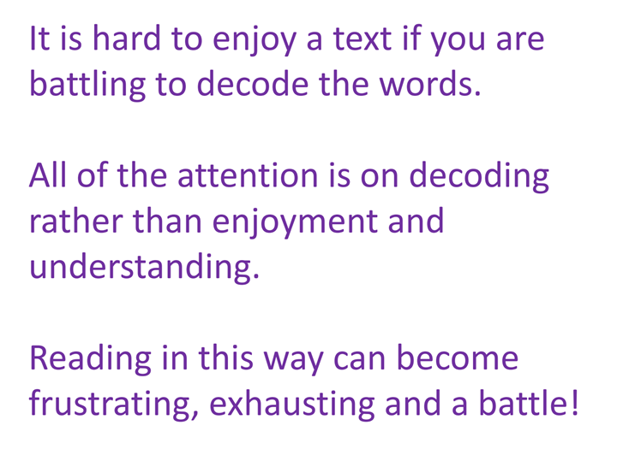

Slide 11
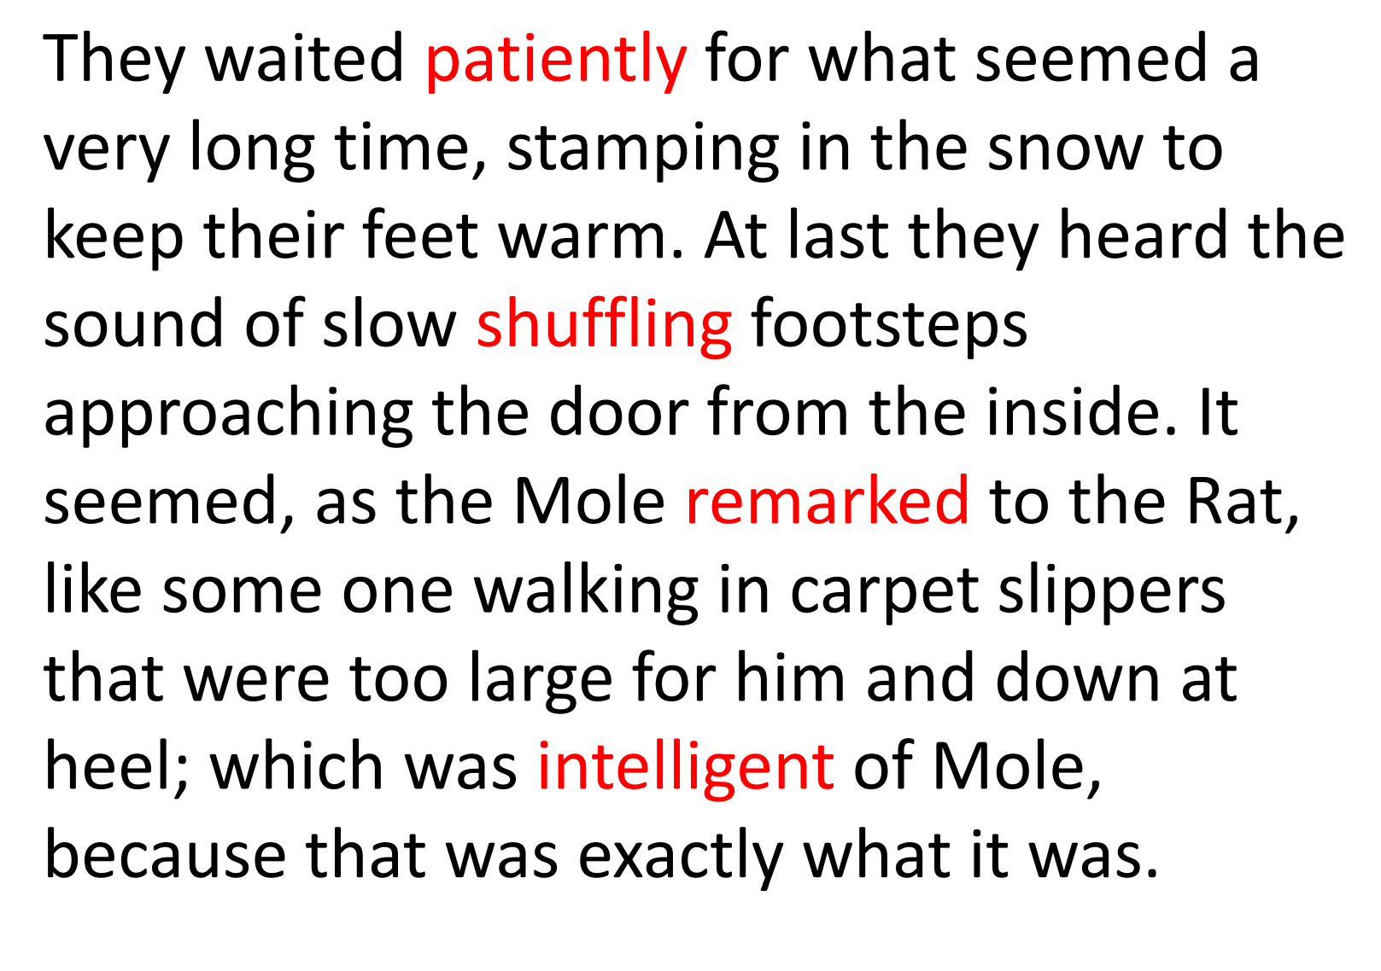

Slide 12
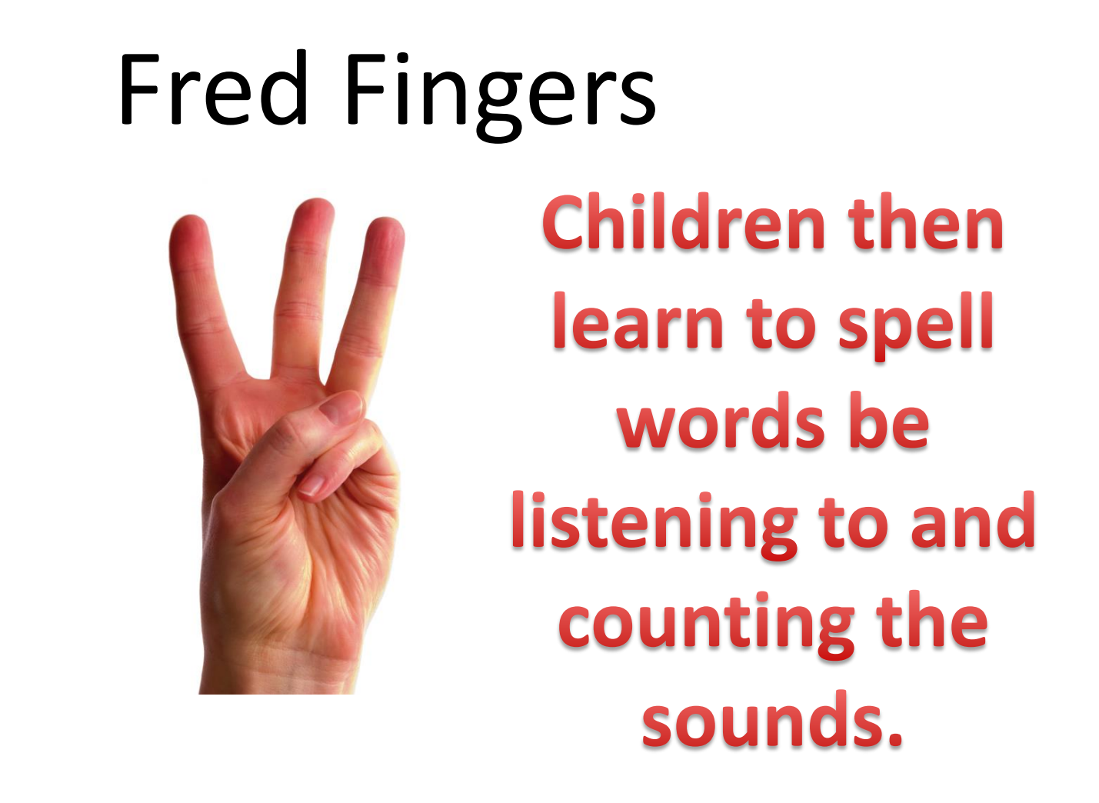
y

Slide 13
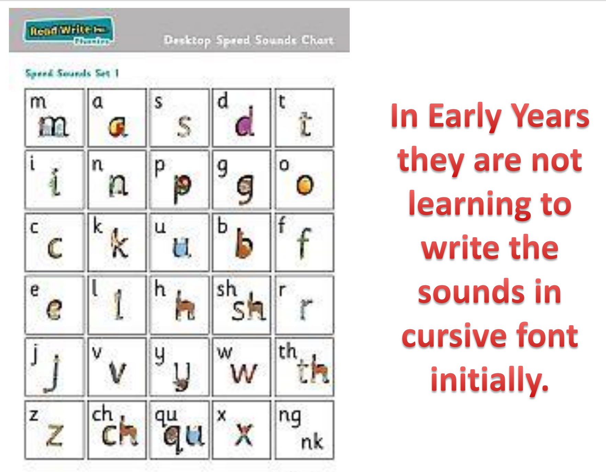

Slide 14
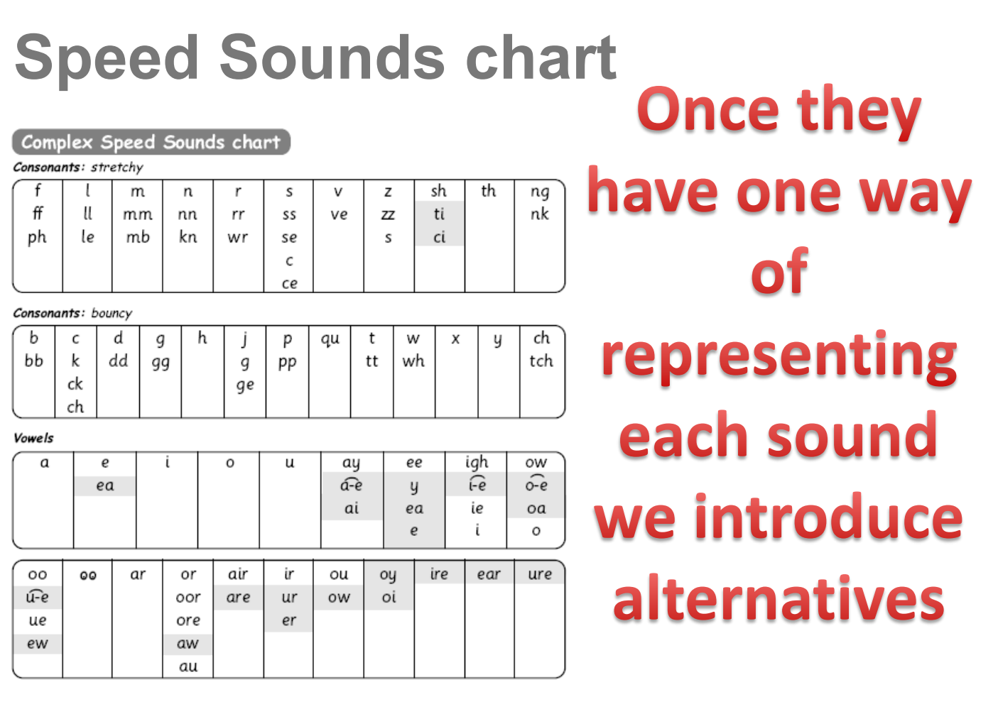

Slide 15
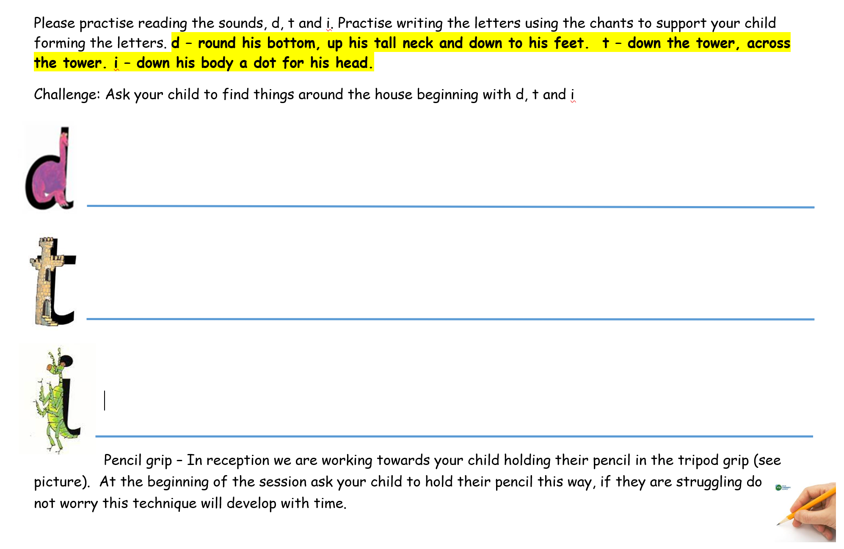
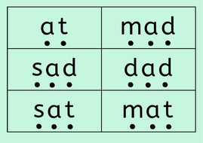
Supporting phonic development at home

Slide 16
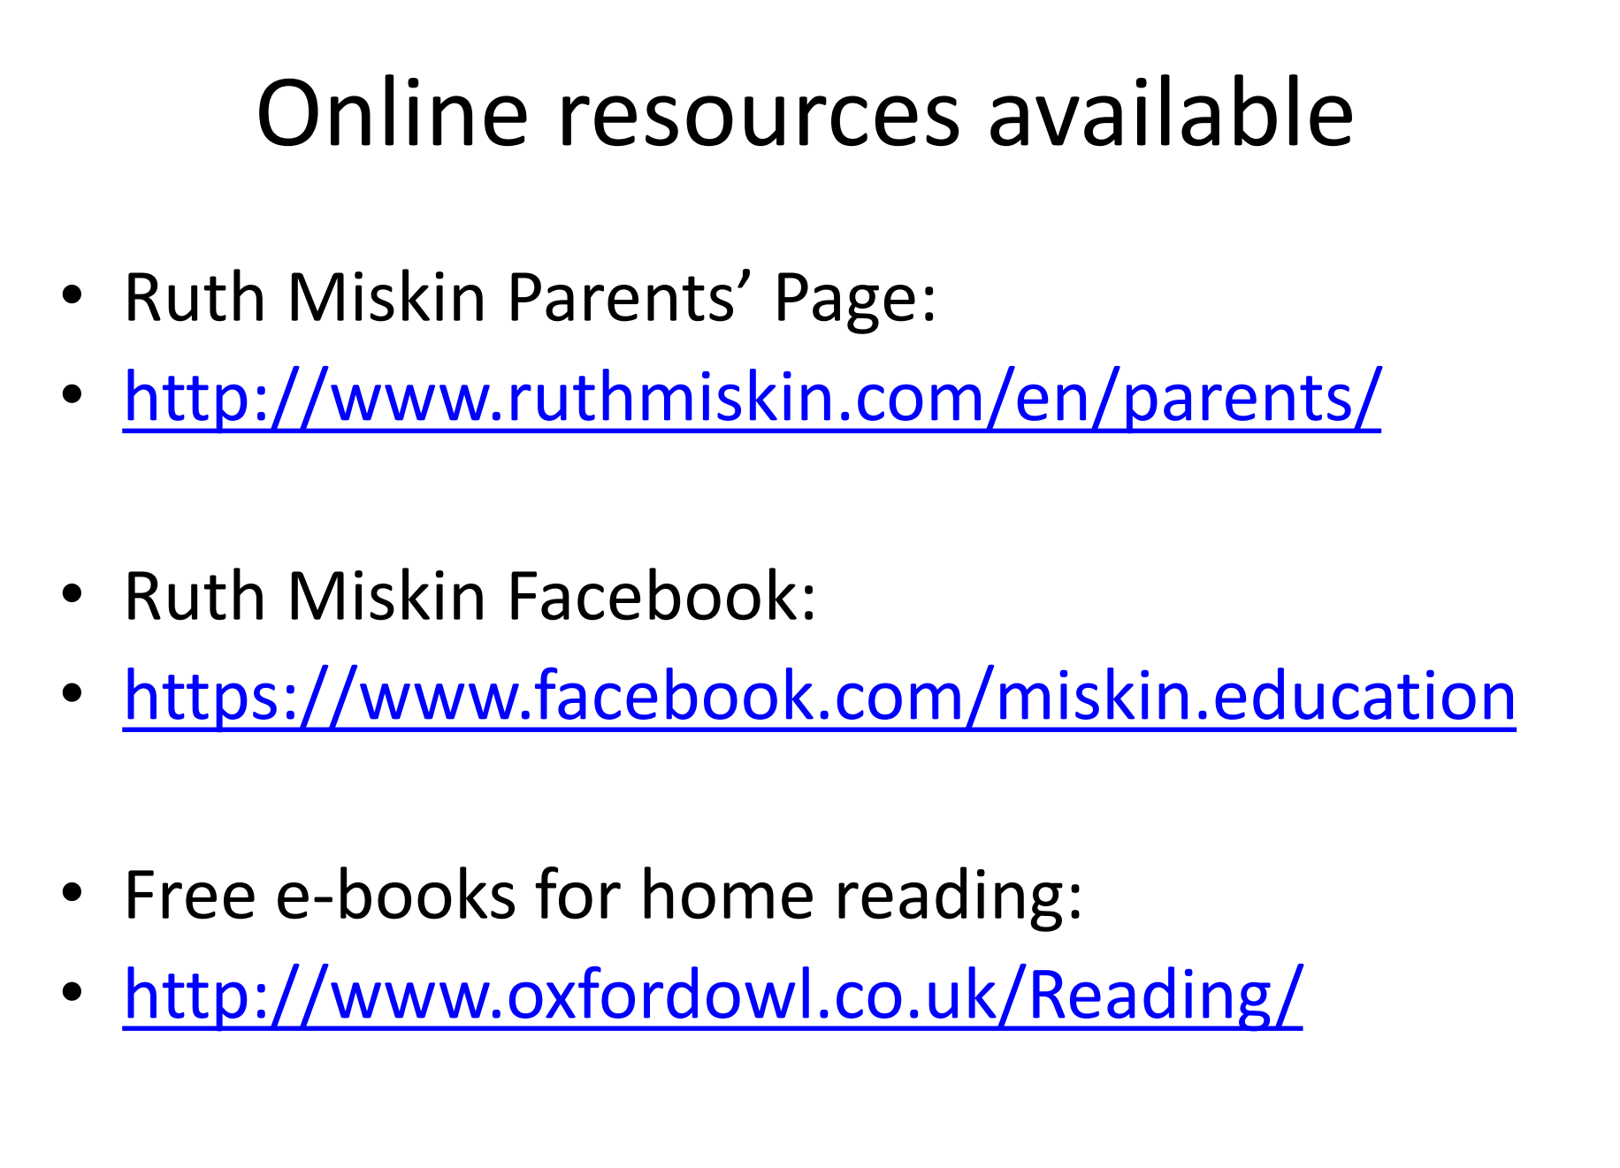

Slide 17

What is inside your child’s bookbag?
Sharing/library book
Read, Write Inc Activity/book(s)
Phonics home learning
Reading Record – comment and sign
Key words

Slide 18
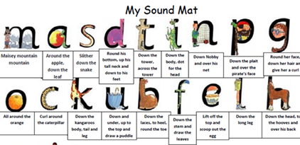
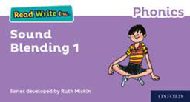
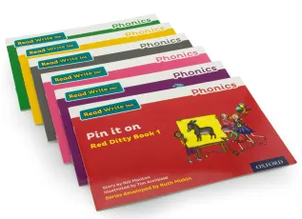

Read Write Inc Books/Activities
My Phonics book
Phonic activities
(first 10 phonemes)
Sound blending
red & green words

Slide 19
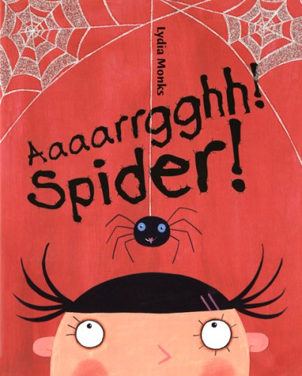
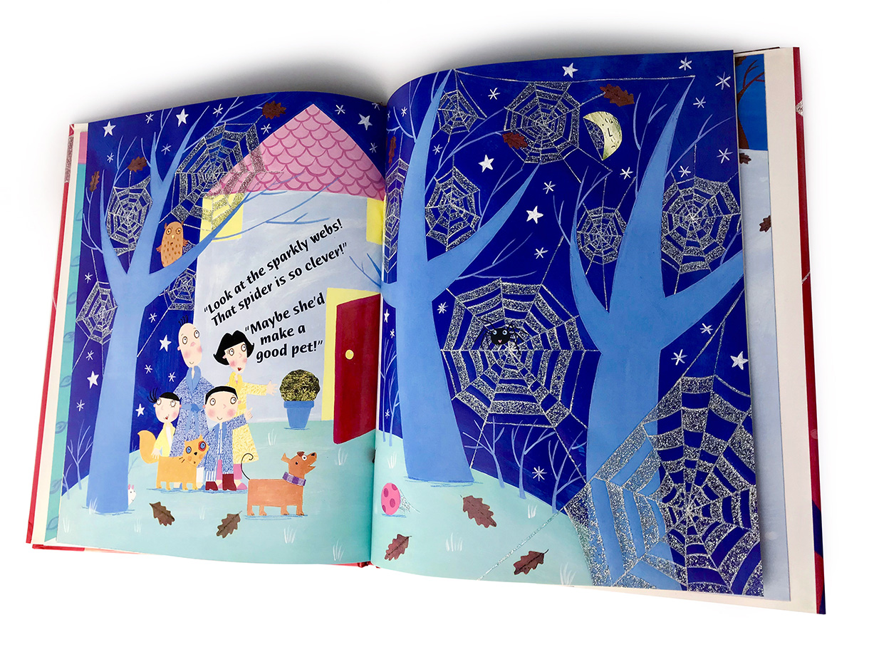
The importance of reading to your child
Engagement, capturing imagination – promoting love of reading
Pupils acquire knowledge through books - EYFS
Vocabulary – lonely – sad as not in the company of others
Vocabulary links to future academic success
PSED – empathy, exploring emotions
UTW – caring for animals and living things

Slide 20
Thank you for joining us today

